Slide 1
Image Enhancement in Frequency Domain

Slide 2
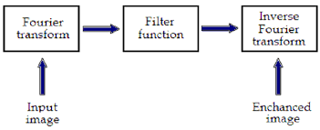
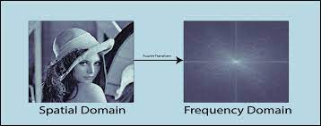
Chapter 4
Lecture 5/6: Image Enhancement in Frequency Domain

Slide 3
Contents
Sampling and the Fourier Transform of Sampled Functions
DFT of One Variable
Extension to Functions of Two Variables
Some Properties of the 2-D Discrete Fourier Transform
Basics of Filtering in the Frequency Domain
Image Smoothing using Frequency Domain Filters
Image Sharpening using Frequency Domain Filters
Selective Filtering

Slide 4
Signals in Frequency Domain
Any function that periodically repeats itself can be expressed as the sum of sines and/or cosines of different frequencies, each multiplied by a different coefficient (Fourier series).
Even functions that are not periodic (but whose area under the curve is finite) can be expressed as the integral of sines and/or cosines multiplied by a weighting function (Fourier transform).

Slide 5
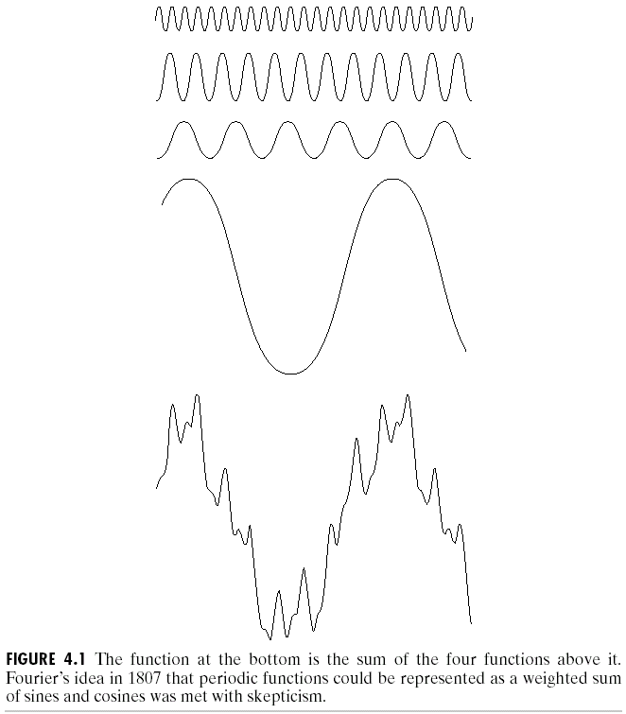
Signals in Frequency Domain
The frequency domain refers to the plane of the two dimensional discrete Fourier transform of an image.
The purpose of the Fourier transform is to represent a signal as a linear combination of sinusoidal signals of various frequencies.

Slide 6
Signals in Frequency Domain
The one-dimensional Fourier transform and its inverse
  Fourier transform (continuous case)
  Inverse Fourier transform:
The two-dimensional Fourier transform and its inverse
  Fourier transform (continuous case)
  Inverse Fourier transform:

Slide 7
Signals in Frequency Domain
The one-dimensional Fourier transform and its inverse
  Fourier transform (discrete case) DTC
  Inverse Fourier transform:

Slide 8
Signals in Frequency Domain
Since and the fact
then discrete Fourier transform can be redefined
  Frequency (time) domain: the domain (values of u) over which the values of F(u) range; because u determines the frequency of the components of the transform.
  Frequency (time) component: each of the M terms of F(u).

Slide 9
Signals in Frequency Domain
F(u) can be expressed in polar coordinates:
  R(u): the real part of F(u)
  I(u): the imaginary part of F(u)
Power spectrum:

Slide 10
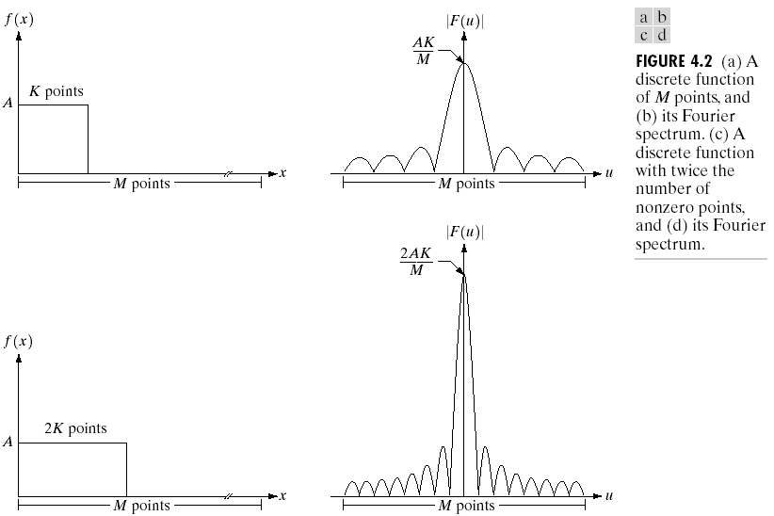
Signals in Frequency Domain

Slide 11
Signals in Frequency Domain
The two-dimensional Fourier transform and its inverse
  Fourier transform (discrete case) DTC
  Inverse Fourier transform:
    u, v : the transform or frequency variables
    x, y : the spatial or image variables

Slide 12
Signals in Frequency Domain
We define the Fourier spectrum, phase angle, and power spectrum as follows:
  R(u,v): the real part of F(u,v)
  I(u,v): the imaginary part of F(u,v)

Slide 13
Signals in Frequency Domain
Some properties of Fourier transform:

Slide 14
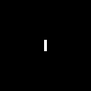
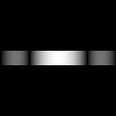
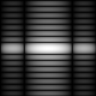
Signals in Frequency Domain
The 2D DFT F(u,v) can be obtained by
taking the 1D DFT of every row of image f(x,y), F(u,y),
taking the 1D DFT of every column of F(u,v)
(a)f(x,y) (b)F(u,y) (c)F(u,v)

Slide 15
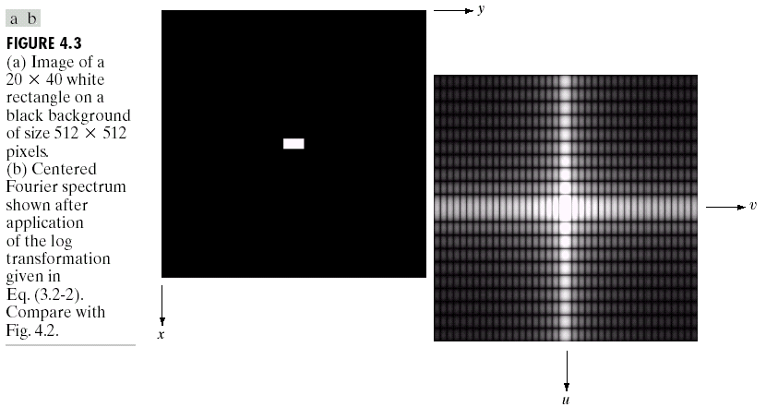
Signals in Frequency Domain
shift

Slide 16
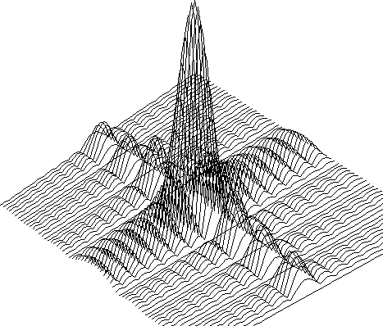
Signals in Frequency Domain

Slide 17

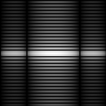
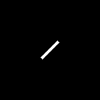
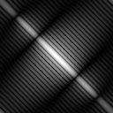
Signals in Frequency Domain
DFT
DFT

Slide 18

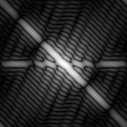
The Property of Two-Dimensional DFT
Linear Combination
A
DFT
B
DFT
0.25 * A
+ 0.75 * B
DFT

Slide 19
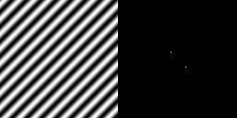
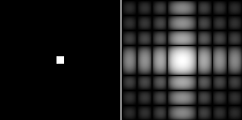
Two-Dimensional DFT with Different Functions
Sine wave
Its DFT
Rectangle
Its DFT

Slide 20

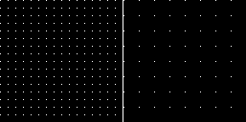
Two-Dimensional DFT with Different Functions
2D Gaussian
function
Its DFT
Impulses
Its DFT

Slide 21
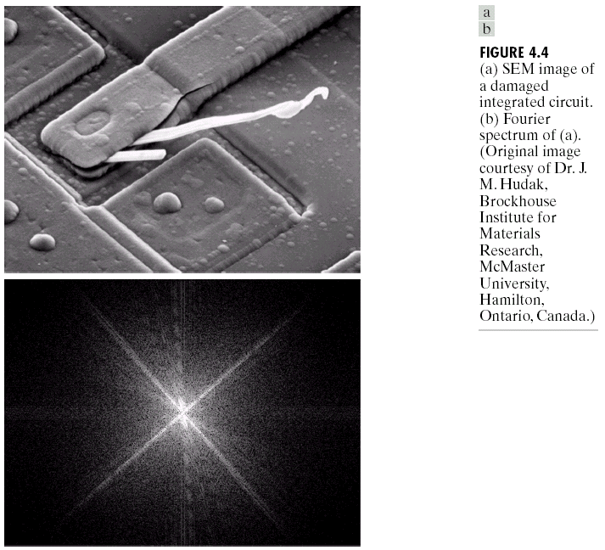
Filtering in the Frequency Domain

Slide 22
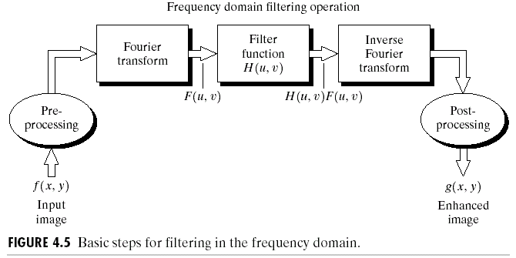
Basics of Filtering in the Frequency Domain

Slide 23
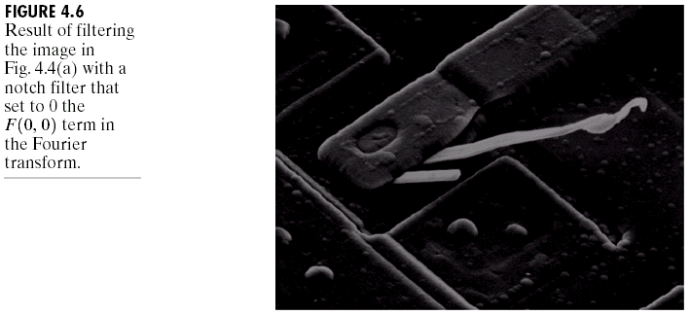
Some Basic Filters and Their Functions
Multiply all values of F(u,v) by the filter function (notch filter):
  All this filter would do is set F(0,0) to zero (force the average value of an image to zero) and leave all frequency components of the Fourier transform untouched.

Slide 24
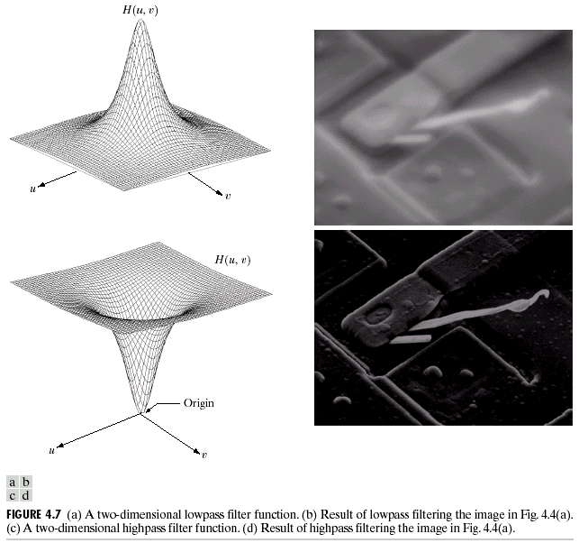
Some Basic Filters and Their Functions
Lowpass filter
Highpass filter

Slide 25
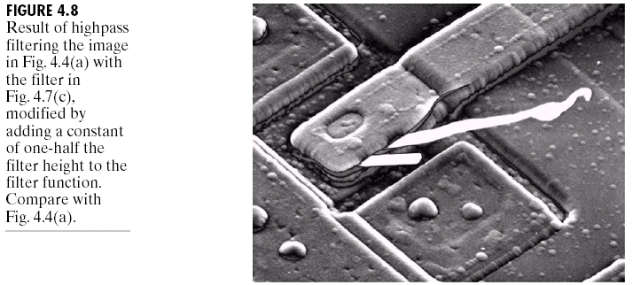
Some Basic Filters and Their Functions

Slide 26
Correspondence between Filtering in
the Spatial and Frequency Domain
Convolution theorem:
  The discrete convolution of two functions f(x,y) and h(x,y) of size M×N is defined as
  Let F(u,v) and H(u,v) denote the Fourier transforms of f(x,y) and h(x,y), then
  Eq. (4.2-31)
  Eq. (4.2-32)

Slide 27
Correspondence between Filtering in
the Spatial and Frequency Domain
:an impulse function of strength A, located at coordinates (x₀,y₀)
where : a unit impulse located at the origin
The Fourier transform of a unit impulse at the origin (Eq. (4.2-35)) :

Slide 28
Correspondence between Filtering in
the Spatial and Frequency Domain
Let , then the convolution (Eq. (4.2-36))
Combine Eqs. (4.2-35) (4.2-36) with Eq. (4.2-31), we obtain

Slide 29
Correspondence between Filtering in
the Spatial and Frequency Domain
Let H(u) denote a frequency domain, Gaussian filter function given the equation
where : the standard deviation of the Gaussian curve.
The corresponding filter in the spatial domain is
Note: Both the forward and inverse Fourier transforms of a Gaussian function are real Gaussian functions.

Slide 30
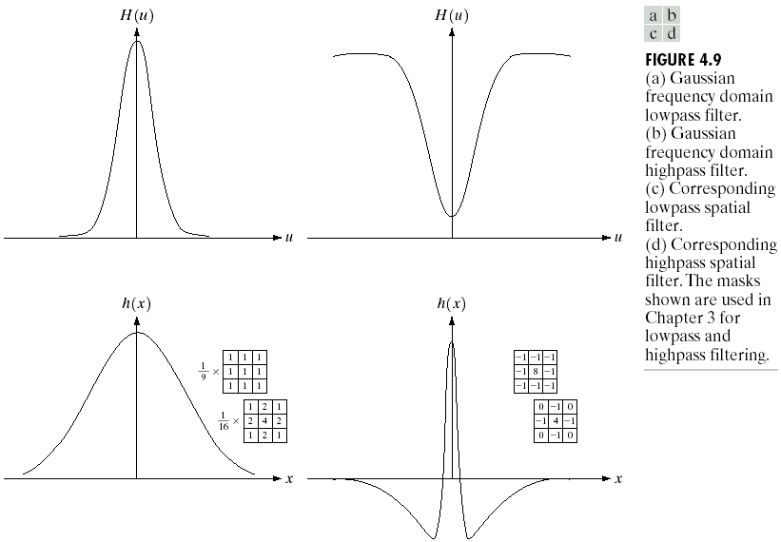
Correspondence between Filtering in
the Spatial and Frequency Domain

Slide 31
Correspondence between Filtering in
the Spatial and Frequency Domain
One very useful property of the Gaussian function is that both it and its Fourier transform are real valued; there are no complex values associated with them.
In addition, the values are always positive. So, if we convolve an image with a Gaussian function, there will never be any negative output values to deal with.
There is also an important relationship between the widths of a Gaussian function and its Fourier transform. If we make the width of the function smaller, the width of the Fourier transform gets larger. This is controlled by the variance parameter σ² in the equations.
These properties make the Gaussian filter very useful for lowpass filtering an image. The amount of blur is controlled by σ². It can be implemented in either the spatial or frequency domain.
Other filters besides lowpass can also be implemented by using two different sized Gaussian functions.

Slide 32
Smoothing Frequency-Domain Filters
The basic model for filtering in the frequency domain
where F(u,v): the Fourier transform of the image to be smoothed
H(u,v): a filter transfer function
Smoothing is fundamentally a lowpass operation in the frequency domain.
There are several standard forms of lowpass filters (LPF).
  Ideal lowpass filter
  Butterworth lowpass filter
  Gaussian lowpass filter

Slide 33
Ideal Lowpass Filters (ILPFs)
The simplest lowpass filter is a filter that “cuts off” all high-frequency components of the Fourier transform that are at a distance greater than a specified distance D₀ from the origin of the transform.
The transfer function of an ideal lowpass filter
where D(u,v) : the distance from point (u,v) to the center of ther frequency rectangle

Slide 34
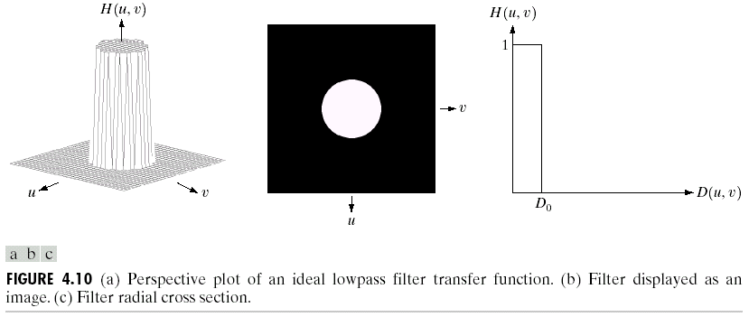
Ideal Lowpass Filters (ILPFs)

Slide 35
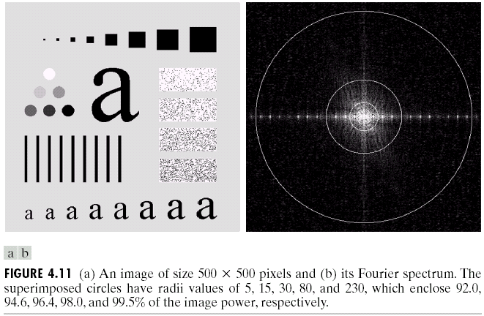
Ideal Lowpass Filters (ILPFs)

Slide 36
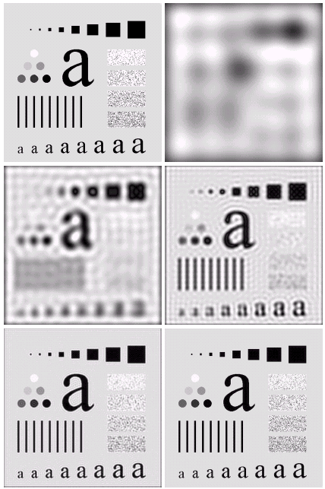

Ideal Lowpass Filters

Slide 37
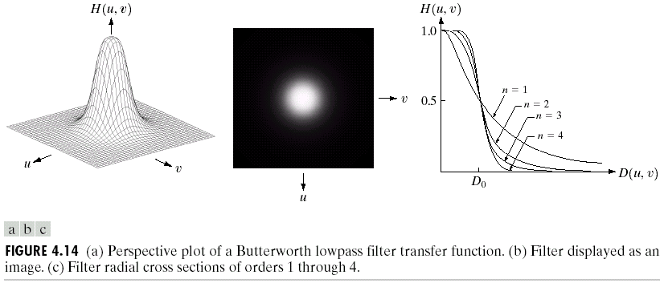
Butterworth Lowpass Filters (BLPFs) with order n

Slide 38
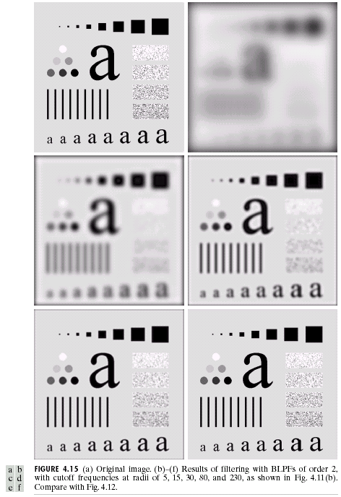
Butterworth Lowpass
Filters (BLPFs)
n=2
D₀=5,15,30,80,and 230

Slide 39
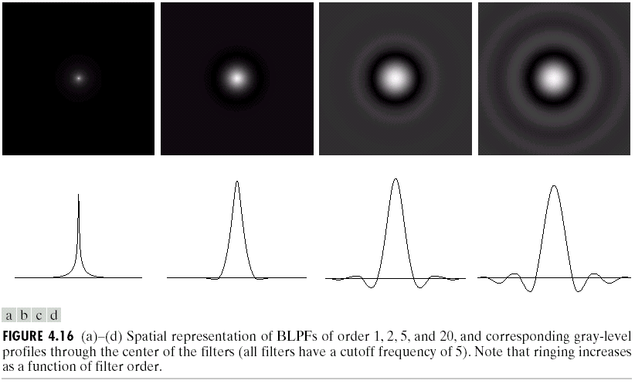
Butterworth Lowpass Filters (BLPFs)
Spatial Representation
n=1
n=2
n=5
n=20

Slide 40
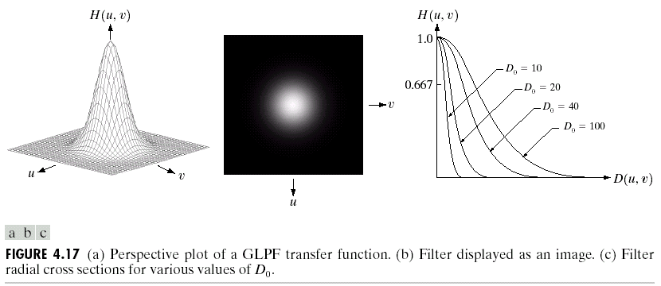
Gaussian Lowpass Filters (FLPFs)

Slide 41
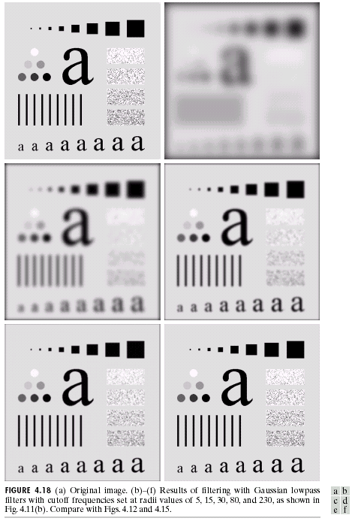
Gaussian Lowpass
Filters (FLPFs)
D₀=5,15,30,80,and 230

Slide 42
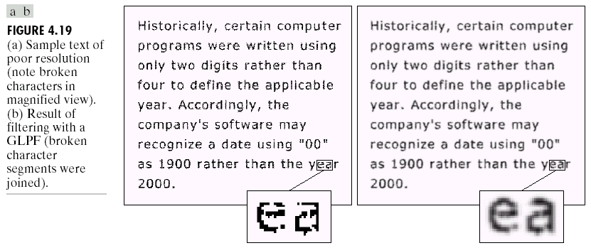
Additional Examples of Lowpass Filtering

Slide 43
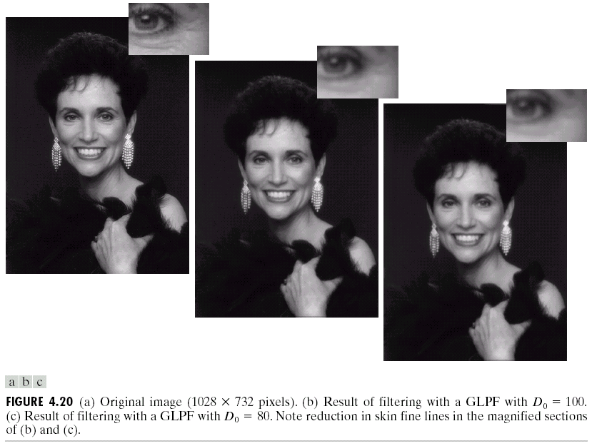
Additional Examples of Lowpass Filtering

Slide 44
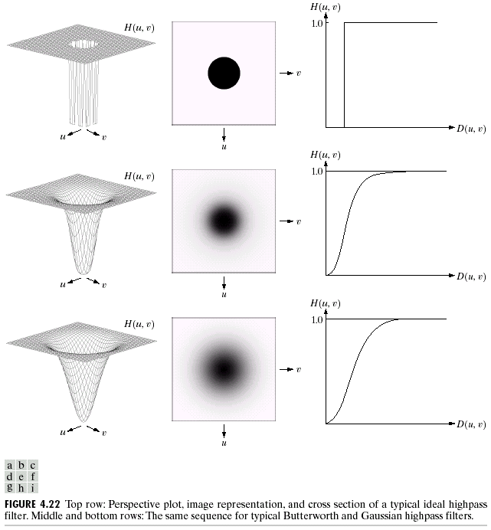



Sharpening Frequency Domain Filter
Ideal highpass filter
Butterworth highpass filter
Gaussian highpass filter

Slide 45
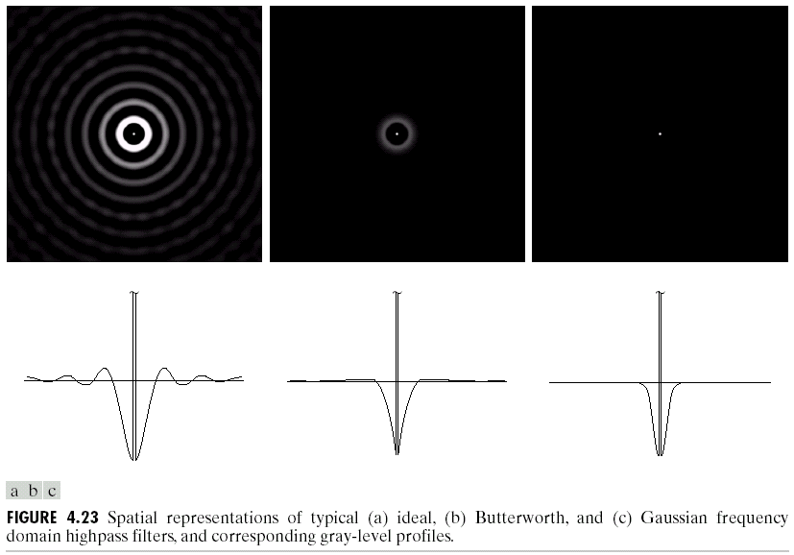
Highpass Filters
Spatial Representations

Slide 46
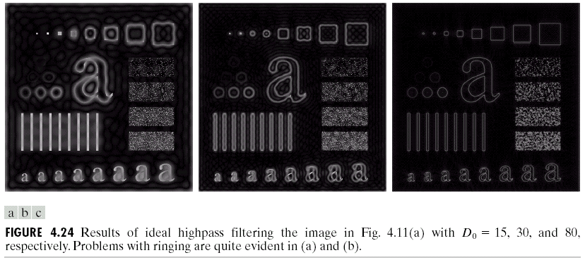
Ideal Highpass Filters

Slide 47
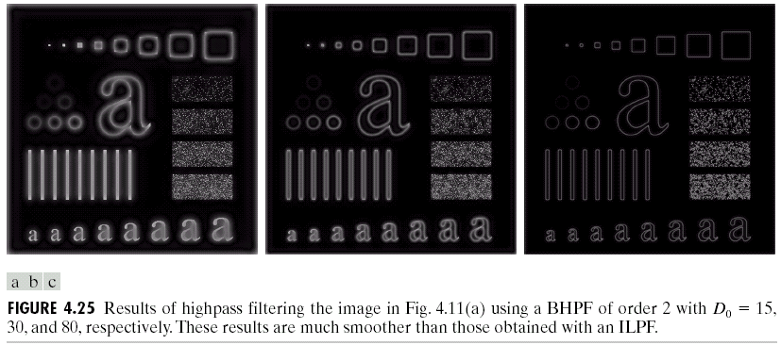
Butterworth Highpass Filters

Slide 48
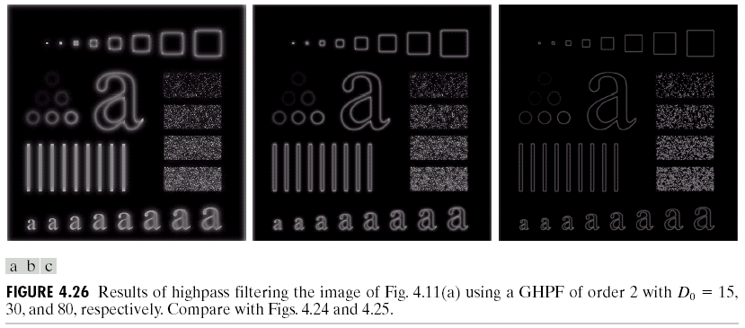
Gaussian Highpass Filters

Slide 49
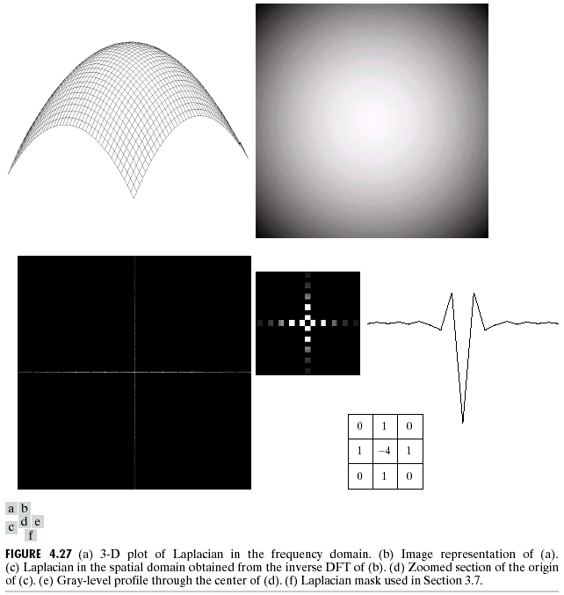
The Laplacian in the Frequency Domain
The Laplacian filter
Shift the center:
Frequency
domain
Spatial domain

Slide 50
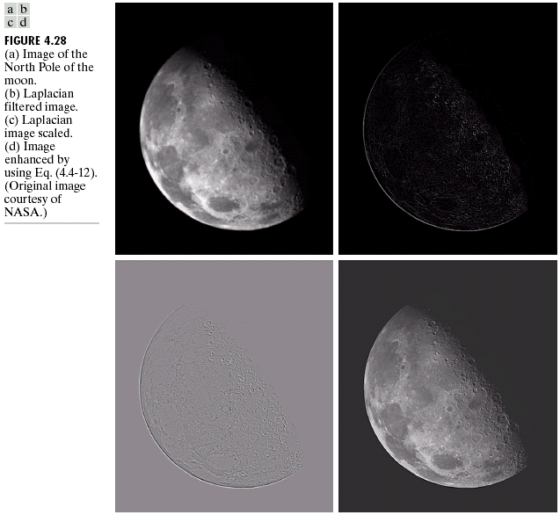

Slide 51
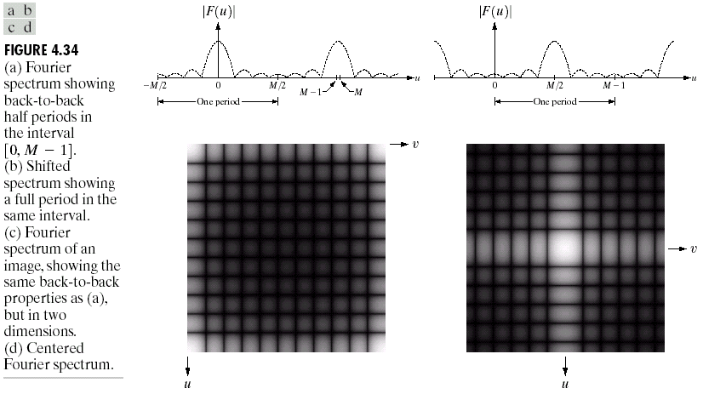
Some Additional Properties of the 2D Fourier Transform
Periodicity, symmetry, and back-to-back properties
shift

Slide 52
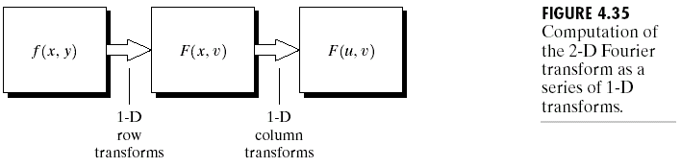
Some Additional Properties of the 2D Fourier Transform
Separability

Slide 53
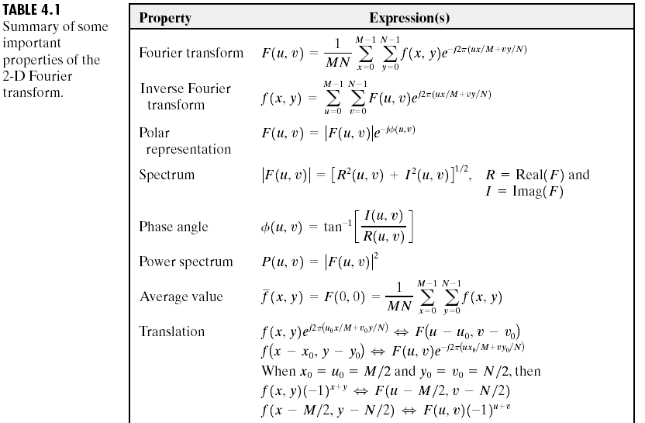
Summary of Some Important Properties
of the 2-D Fourier Transform

Slide 54
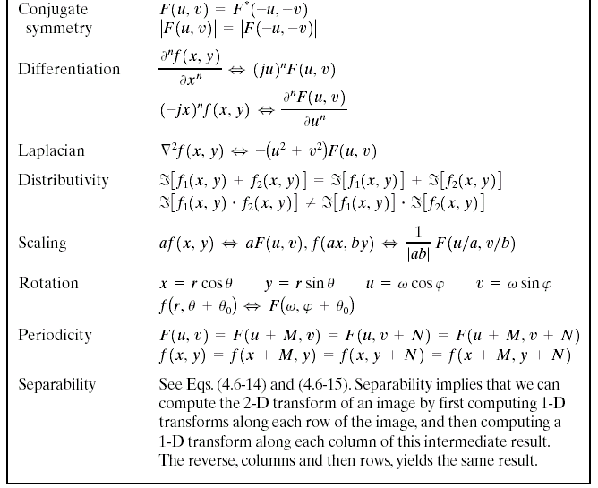

Summary of Some Important Properties
of the 2-D Fourier Transform

Slide 55
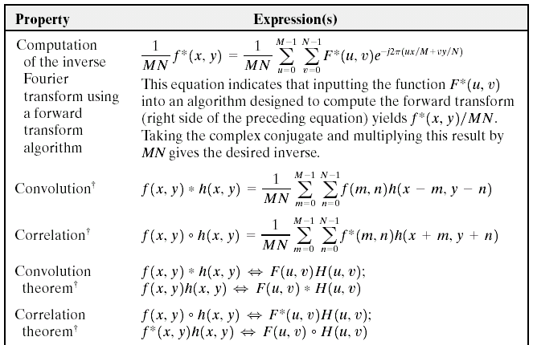
Summary of Some Important Properties
of the 2-D Fourier Transform

Slide 56
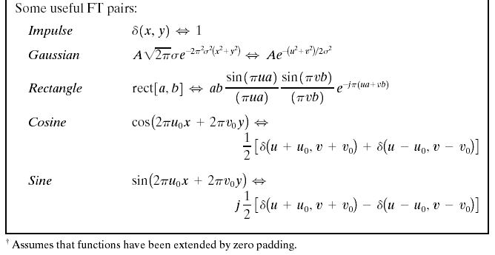
Summary of Some Important Properties
of the 2-D Fourier Transform

Slide 57
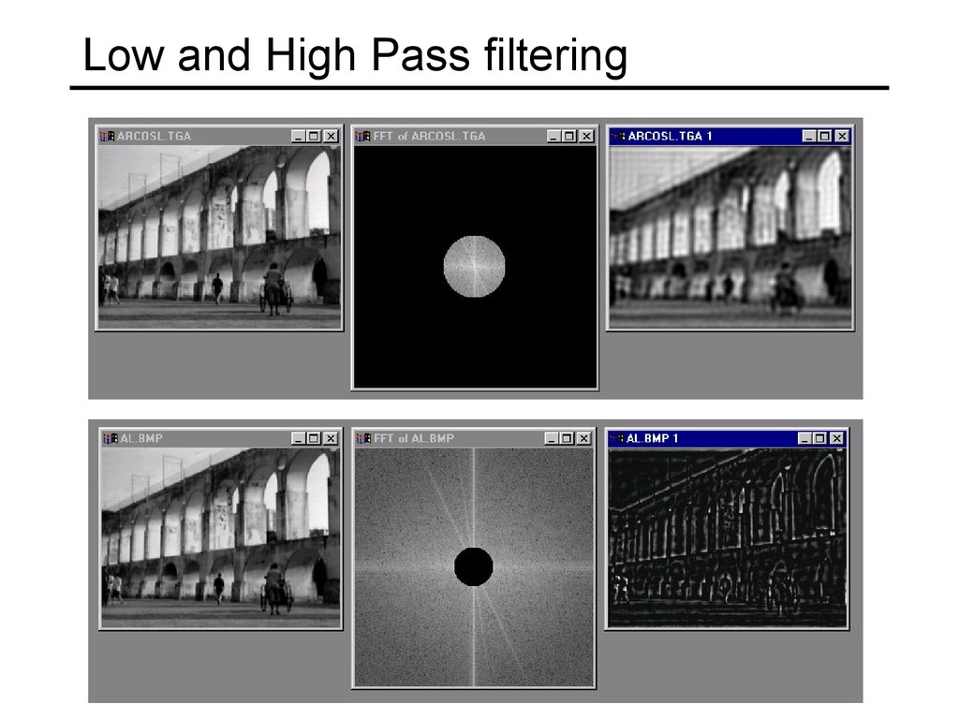
End of Lecture
Chapter 4

