Slide 1
Measurement of Emissivity of Metal Disc
Heat Power Laboratory I (Thermodynamics and Heat Transfer)
ME II Sec A₃
2020-21 2nd Semester
Prof. Achintya Mukhopadhyay

Slide 2
Title:
Measurement of Emissivity of Metal Disc
Objective:
To determine the total hemispherical emissivity of a metal disc at different temperatures

Slide 3
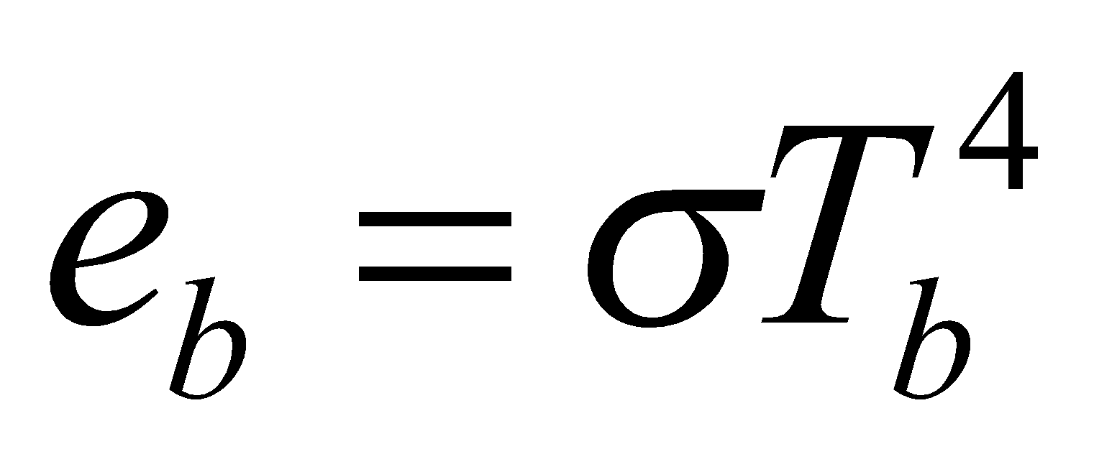
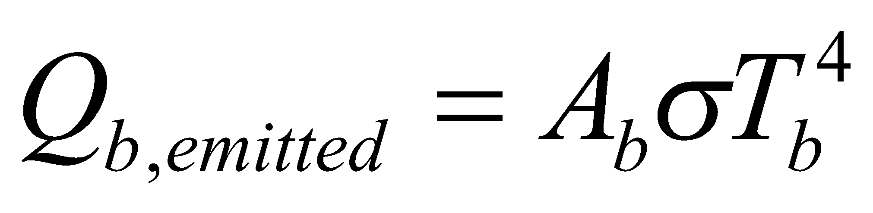
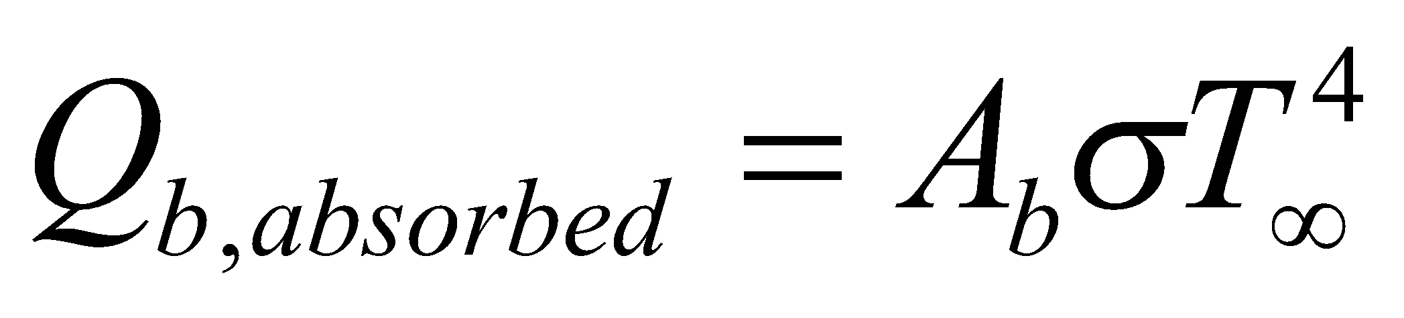
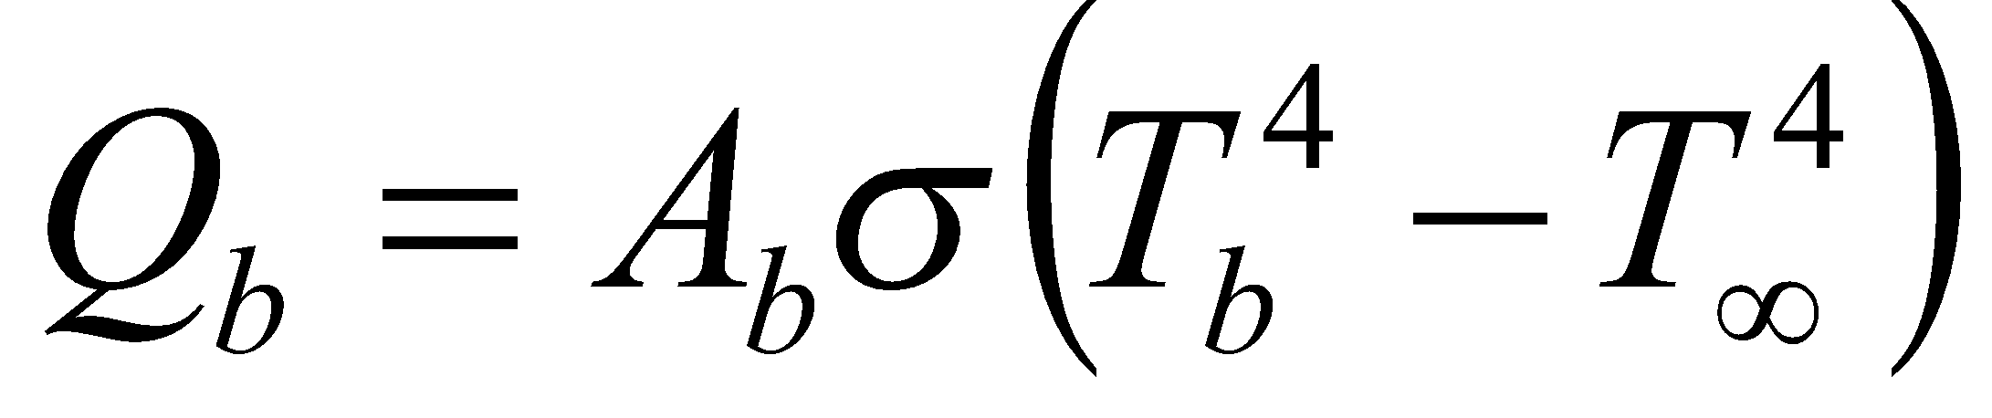
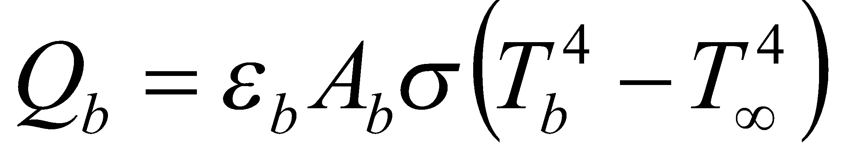
Background Theory
Theory
Schematic Diagram
For a black surface at temperature T_{b},
  Emissive power is given by
  Radiation emitted by a black surface of area A_{b}
  Radiation absorbed by a black surface of area A_{b} from ambient at temperature T∞
  Net rate of heat transfer from black surface to ambient
  Since perfect black surfaces are not possible,
Enclosed in a box to eliminate convective currents
Black plate and metal disc
  Electrically heated to same temperature
  Placed side by side to eliminate mutual radiative exchange
  Insulated at back

Slide 4
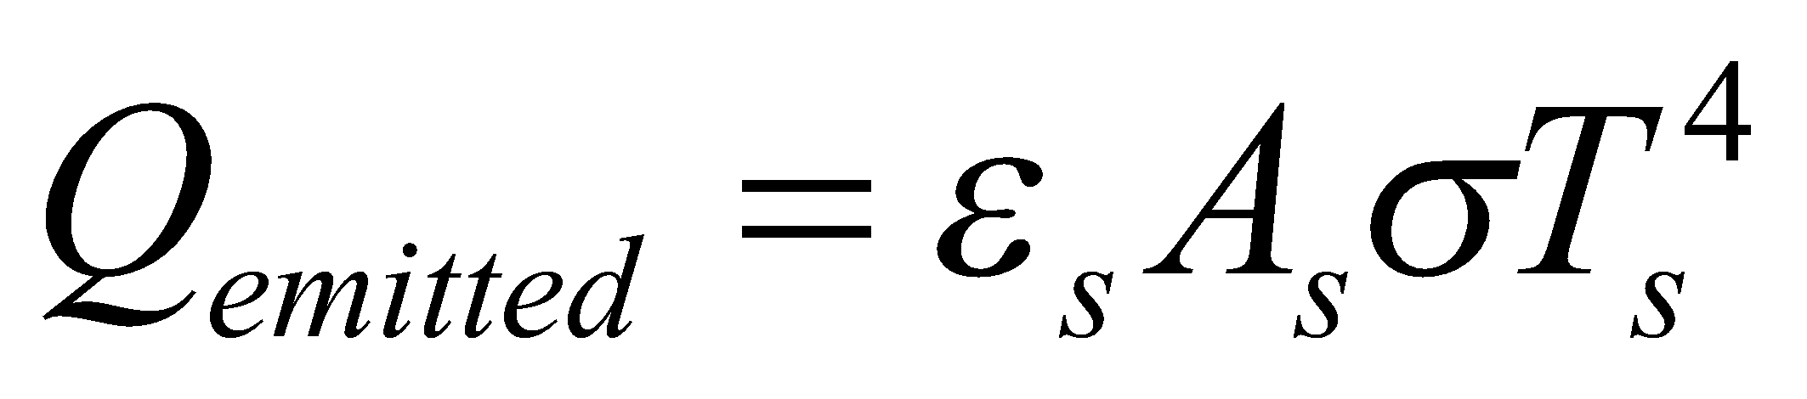
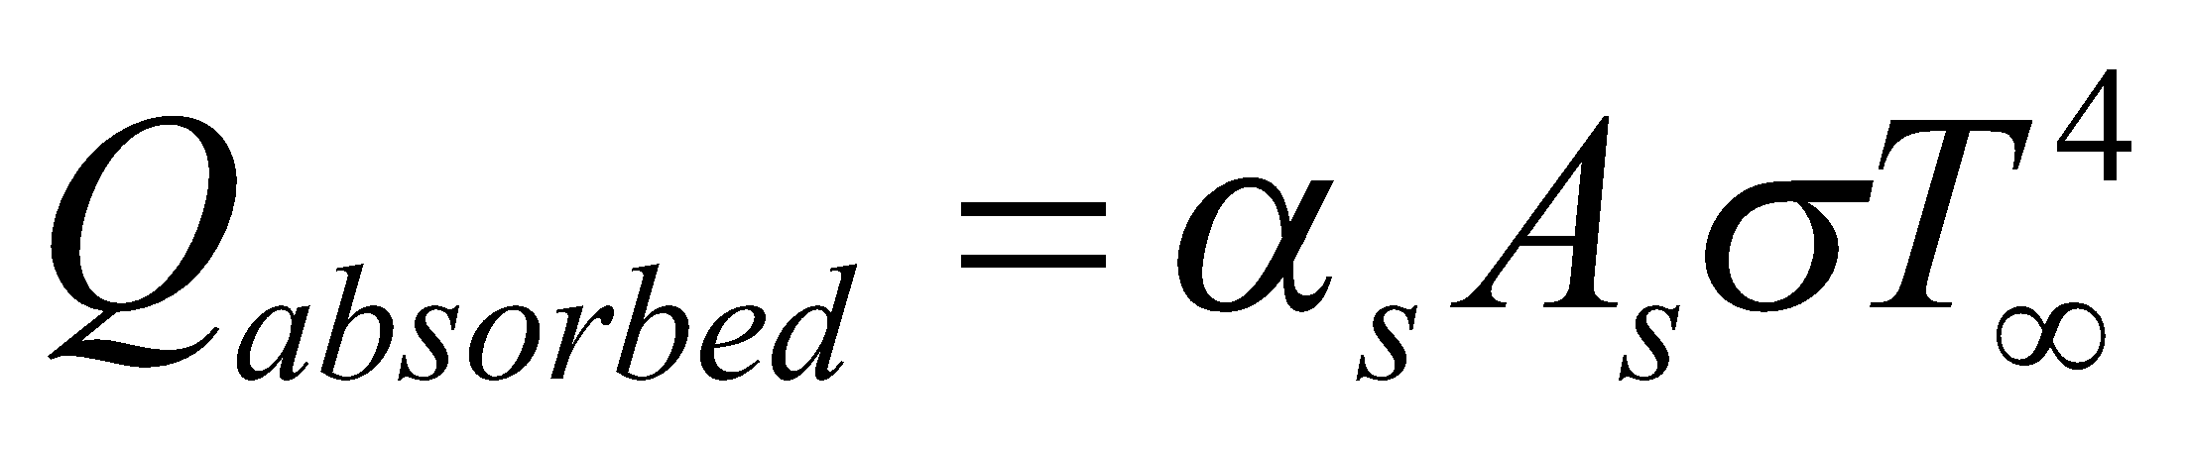
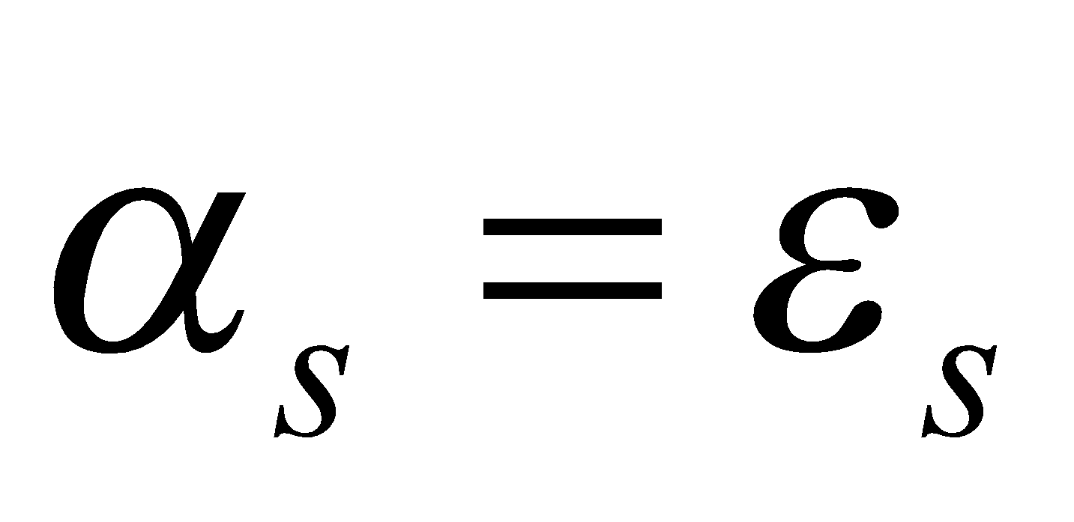
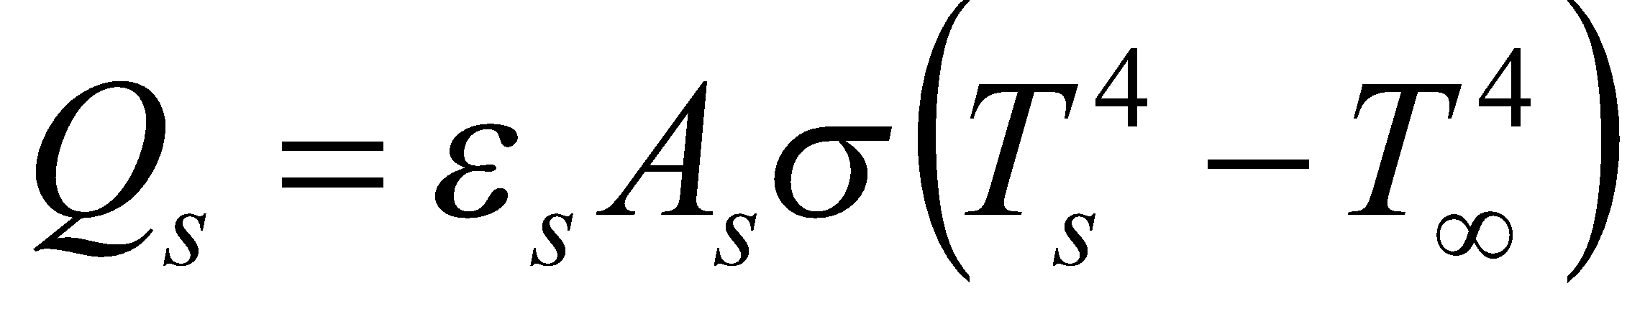
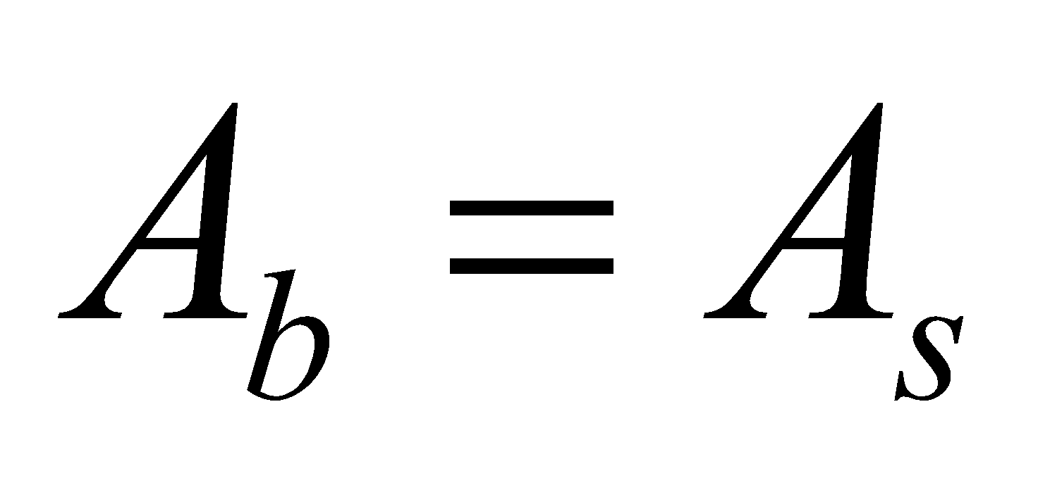
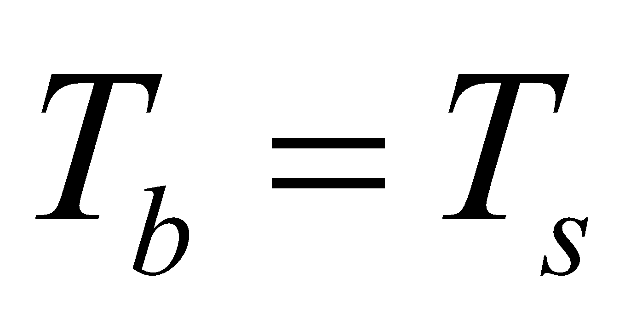
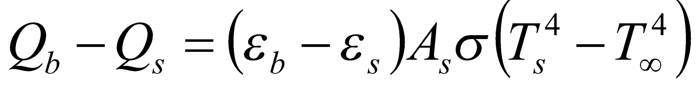
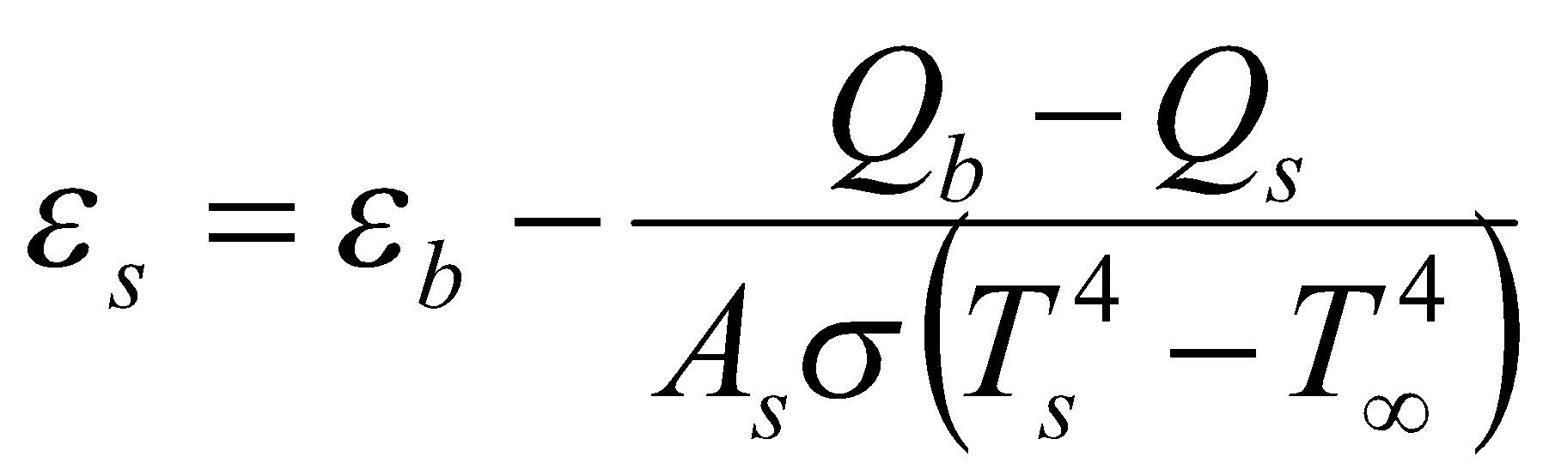
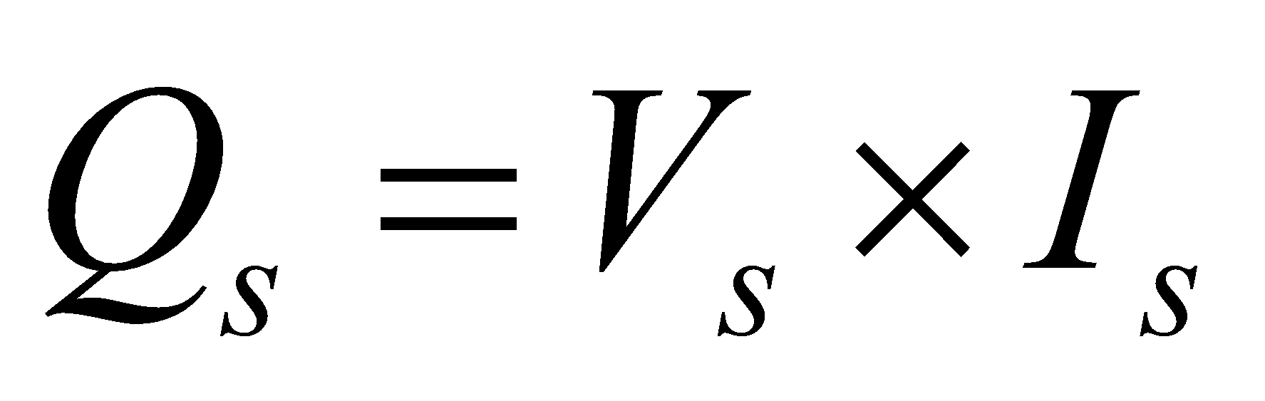
Background Theory
Theory
For a real surface at temperature T_{s},
  Radiation emitted by a real surface of emissivity ε_{s} and area A_{s}
  Radiation absorbed by a real surface of absorptivity α_{s} area A_{s} from ambient at temperature T∞
  For gray diffuse surface,
  Net rate of heat transfer from gray surface to ambient
  For and
  For electrically heated plate
Schematic Diagram
Enclosed in a box to eliminate convective currents
Black plate and metal disc
  Electrically heated to same temperature
  Placed side by side to eliminate mutual radiative exchange
  Insulated at back

Slide 5
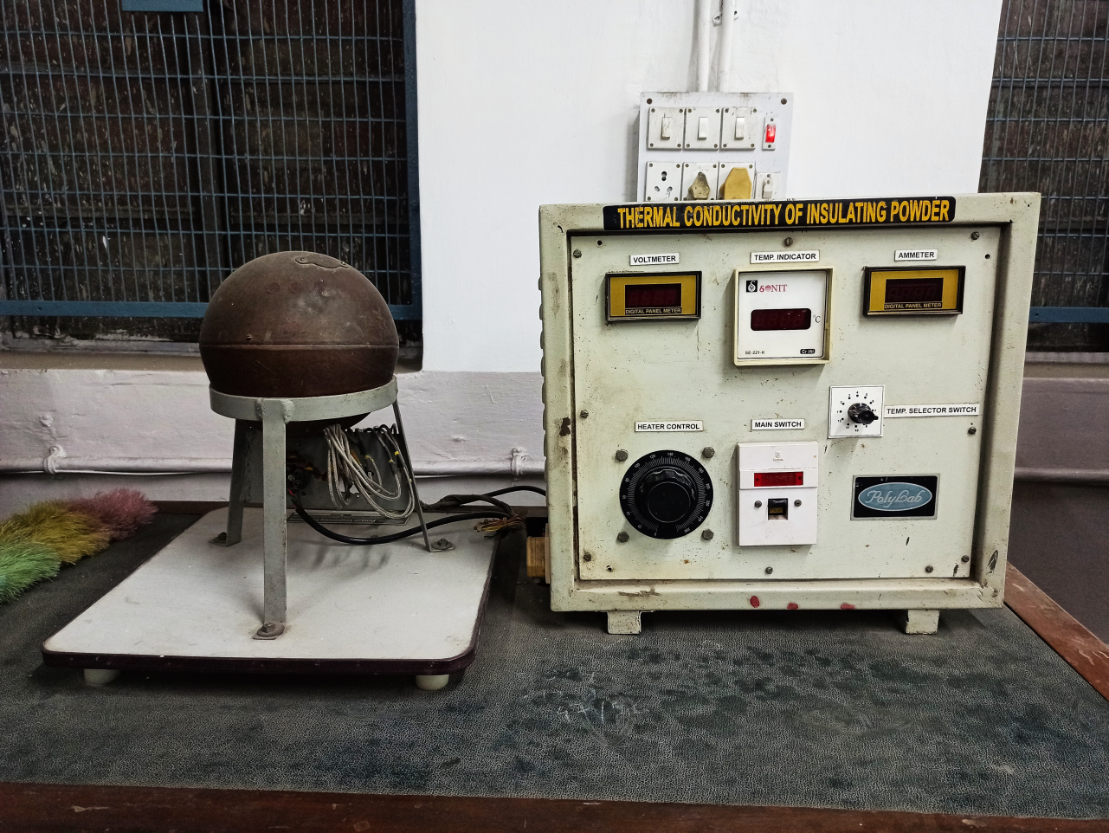
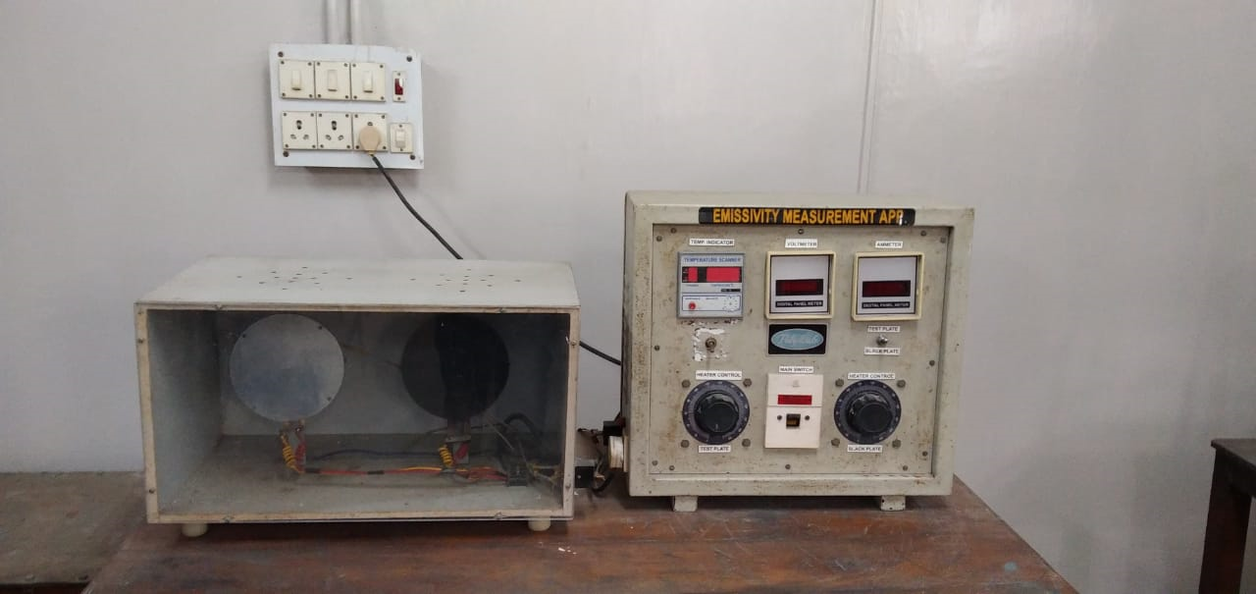
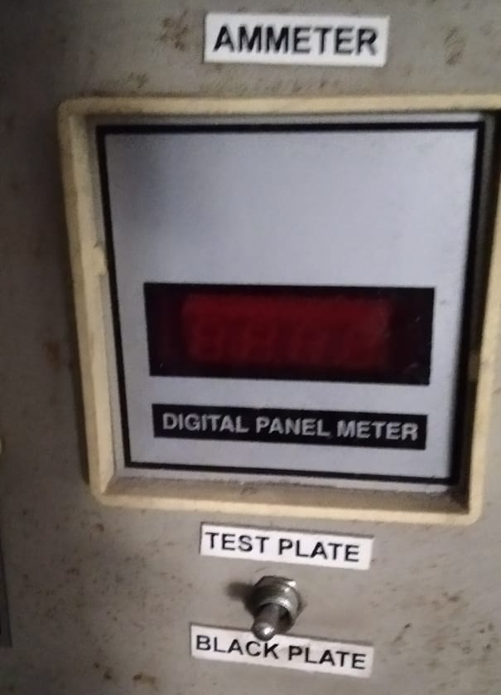
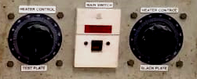
Experimental Setup
Temperature Indicator
Temperature Scanner
Voltmeter
Ammeter
Selector Switch
Temperature Indicator
Box
Metal Plate
Black Plate
Heater
Duct
Heater Control for Test Plate
Heater Control for Black Plate

Slide 6
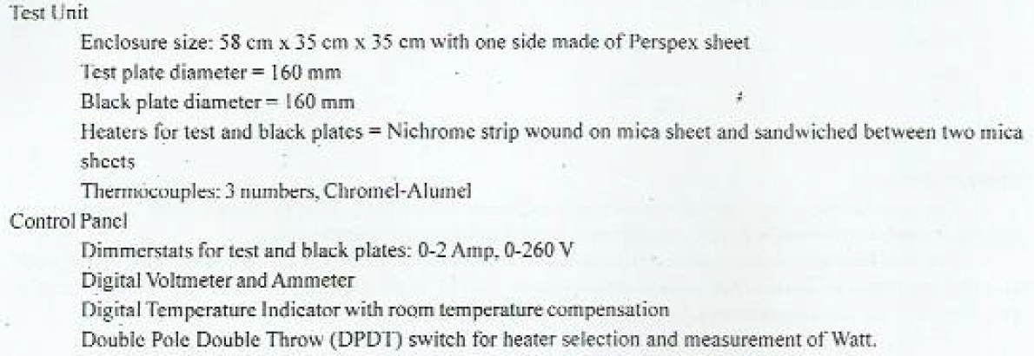
Specifications

Slide 7
Procedure
Give power supply to temperature indicator (230 V, single phase) and adjust the readings in it equal to room temperature by rotating the compensation knob (Normally this is pre-adjusted)
Select the proper range on voltmeter/ ammeter
Gradually increase the input to the heater to black plate and adjust it to some value (30, 50, 75 W) and adjust the heater input to test plate slightly less than the black plate (27, 35, 55 W)
Check the temperature of the two plates and adjust dimmerstat so that the two plates are maintained at the same temperature
  Requires trial and error and more than 1 hour of waiting before steady state is reached
After attaining the steady state record the readings V₁, I₁, V₂, I₂, T₁, T₂, T∞
The procedure is repeated for various surface temperatures in increasing order

Slide 8
Precautions
Use stabilized AC single phase supply
Always keep the dimmerstat at zero position before start
Use proper voltage range on the voltmeter
Gradually increase the heater inputs
See that the black plate is having a uniform layer of lamp black
Never put the heater selector switch at off position i.e., intermediate position

Slide 9
Observations
Sl. No. | Heater Input |  |  |  | Temperature
 | Test Plate |  | Black Plate
 | Voltage V₁ (V) | Current I₁ (A) | Voltage V₂ (V) | Current I₂ (A) | Test Plate T₁ (°C) | Black Plate T₂ (°C) | Ambient T∞ (°C)

Slide 10
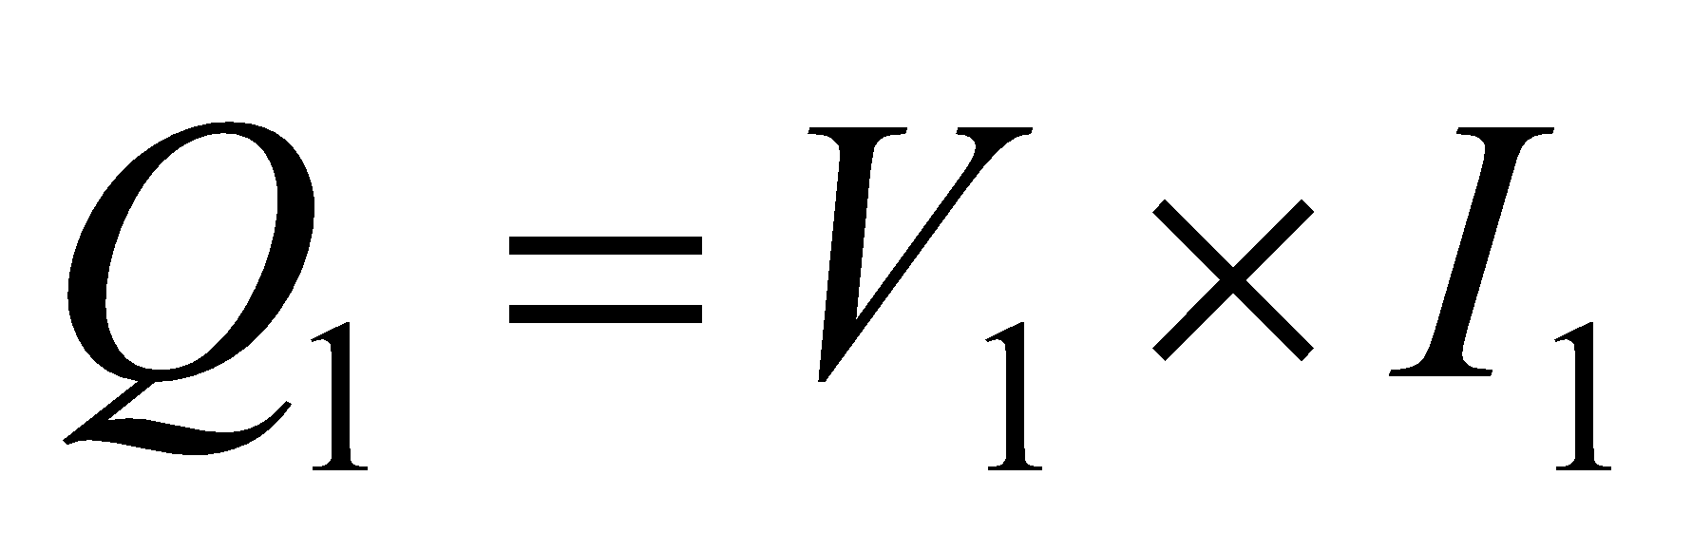
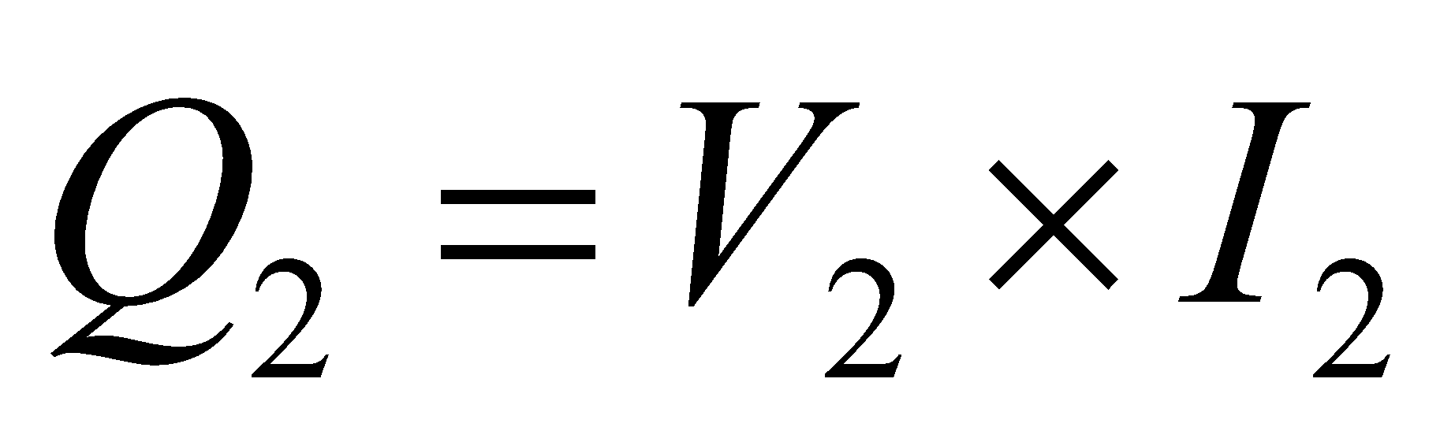
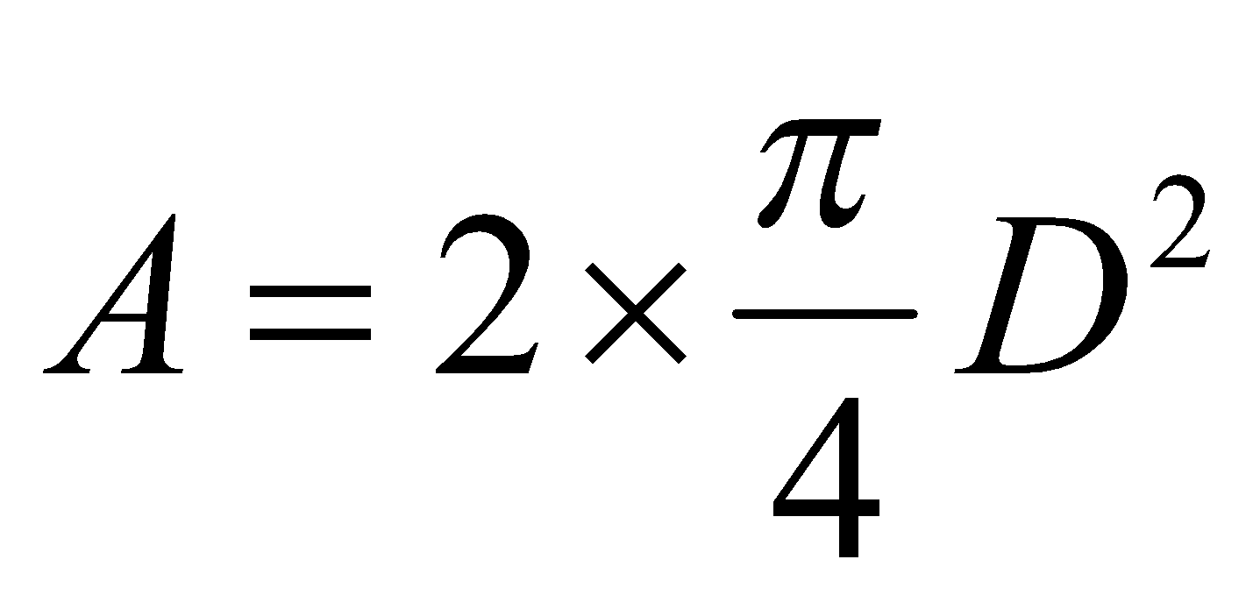
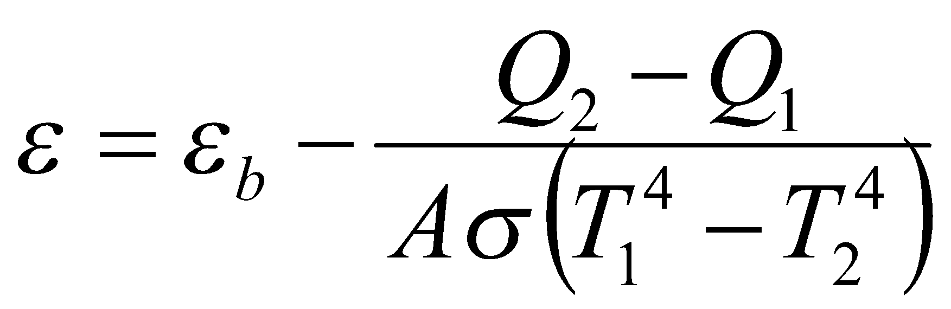
Calculations
Calculate power input to test plate
Calculate power input to black plate
Calculate area of each plate as
Assume ε_{b}=1
Calculate emissivity of test plate as
Plot ε versus T₁
Factor 2 accounts for both sides of the plate

