Slide 1
Heat Transfer from a Pin Fin
Heat Power Laboratory I (Thermodynamics and Heat Transfer)
ME II Sec A₃
2020-21 2nd Semester
Prof. Achintya Mukhopadhyay

Slide 2
Title:
Heat Transfer from a Pin Fin
Objective:
To find out the rate of heat transfer and heat transfer coefficient through a pin fin
To study the temperature distribution along the length of the pin fin

Slide 3
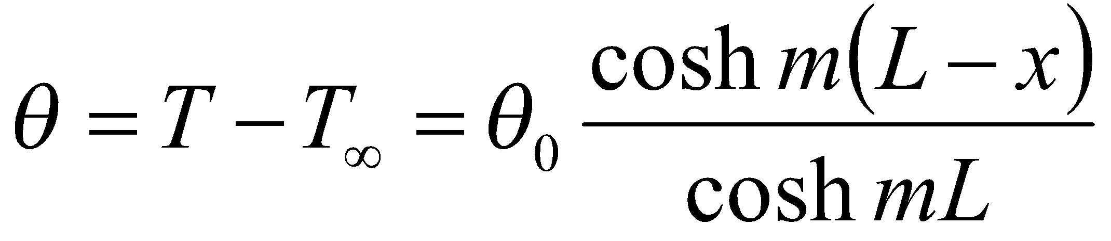
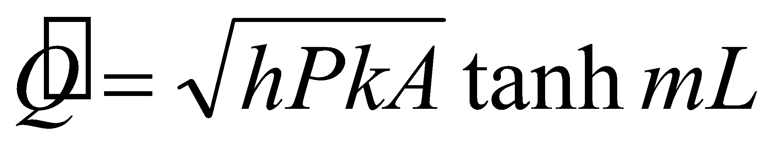
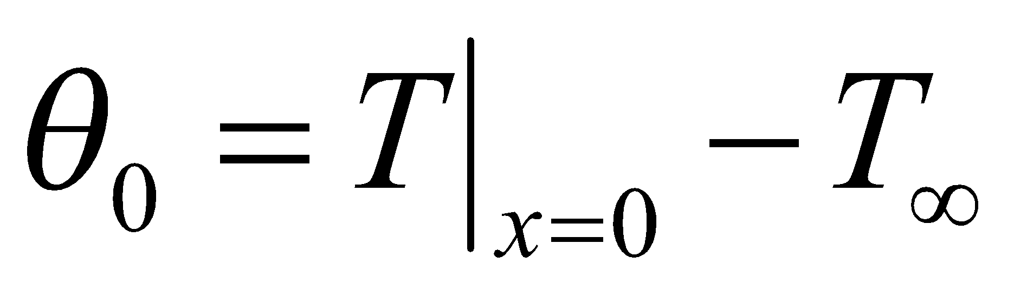
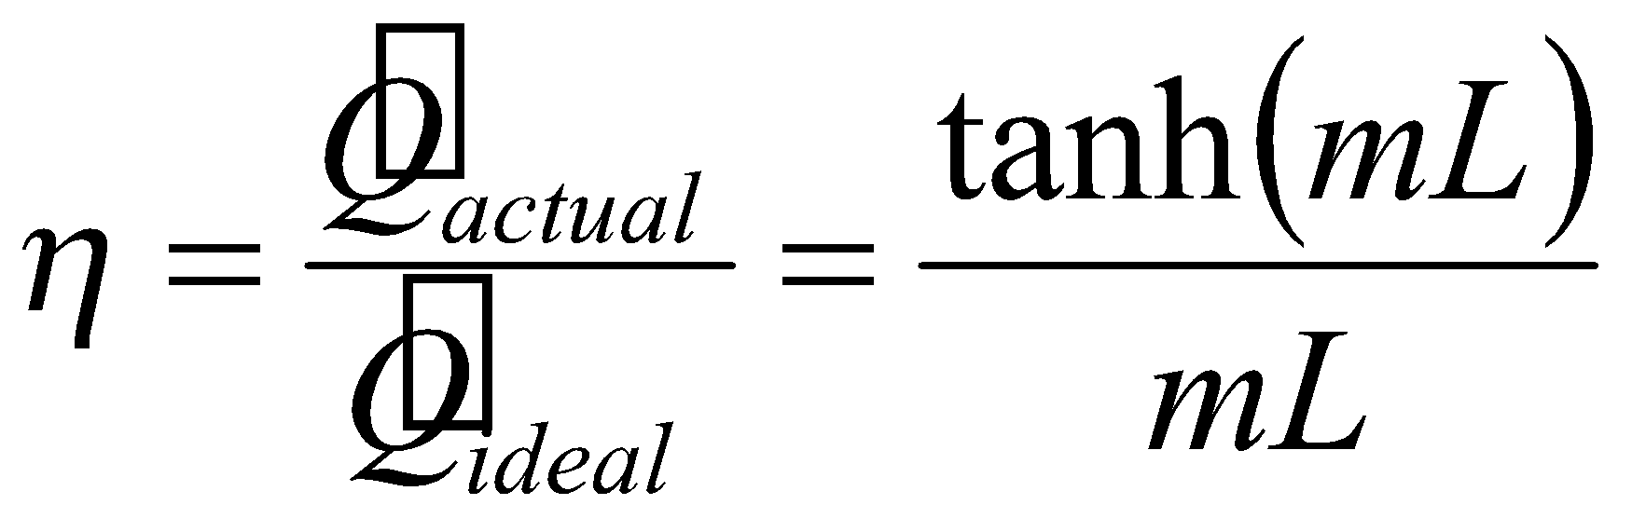
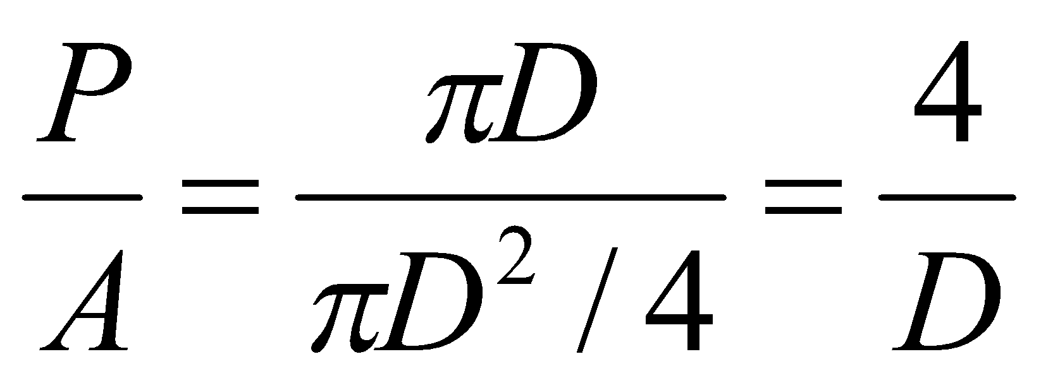
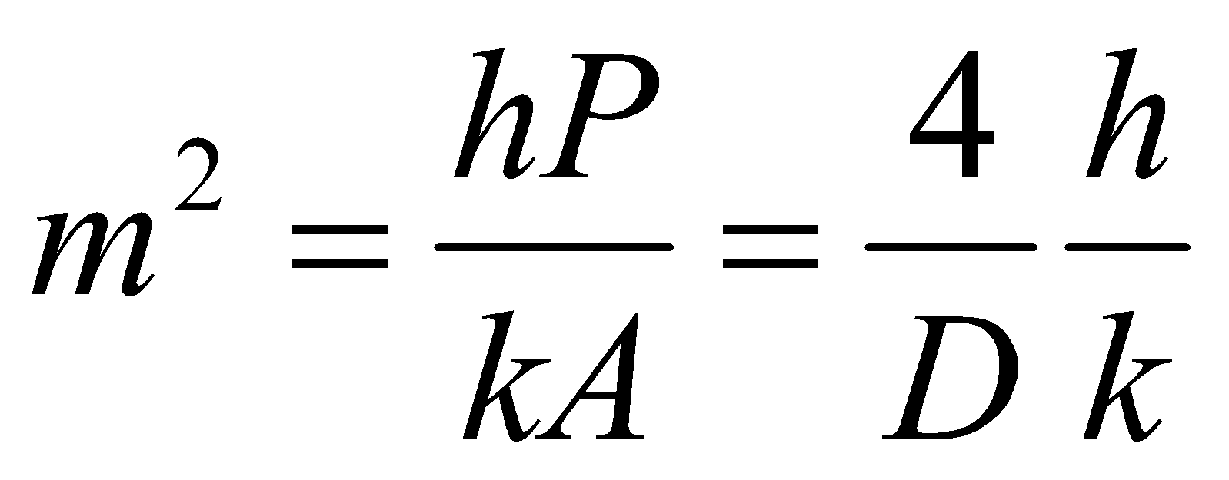
Background Theory
Theory
For 1-dimensional fin with insulated tip
  Temperature distribution
  Rate of heat transfer
  Fin Efficiency
  For a pin fin
  Hence
  How to get h?
Schematic Diagram
L
x
Written in lab sheet as effectiveness
Flow Characteristics
Geometry
Material Properties

Slide 4
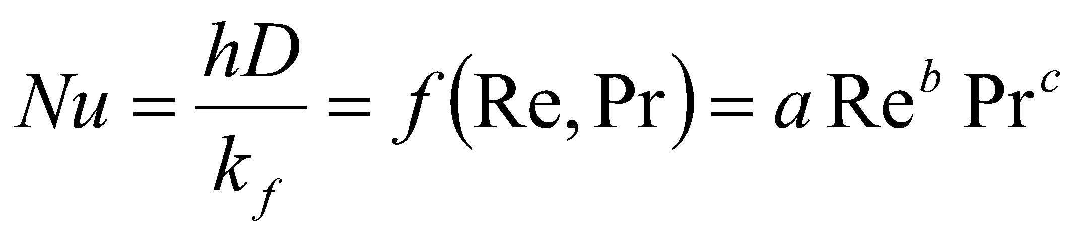
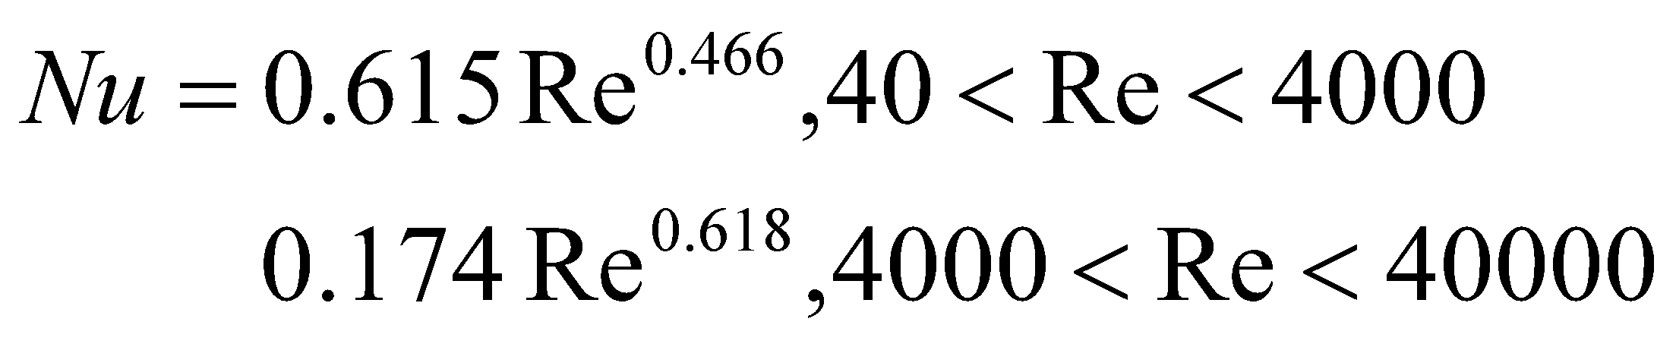
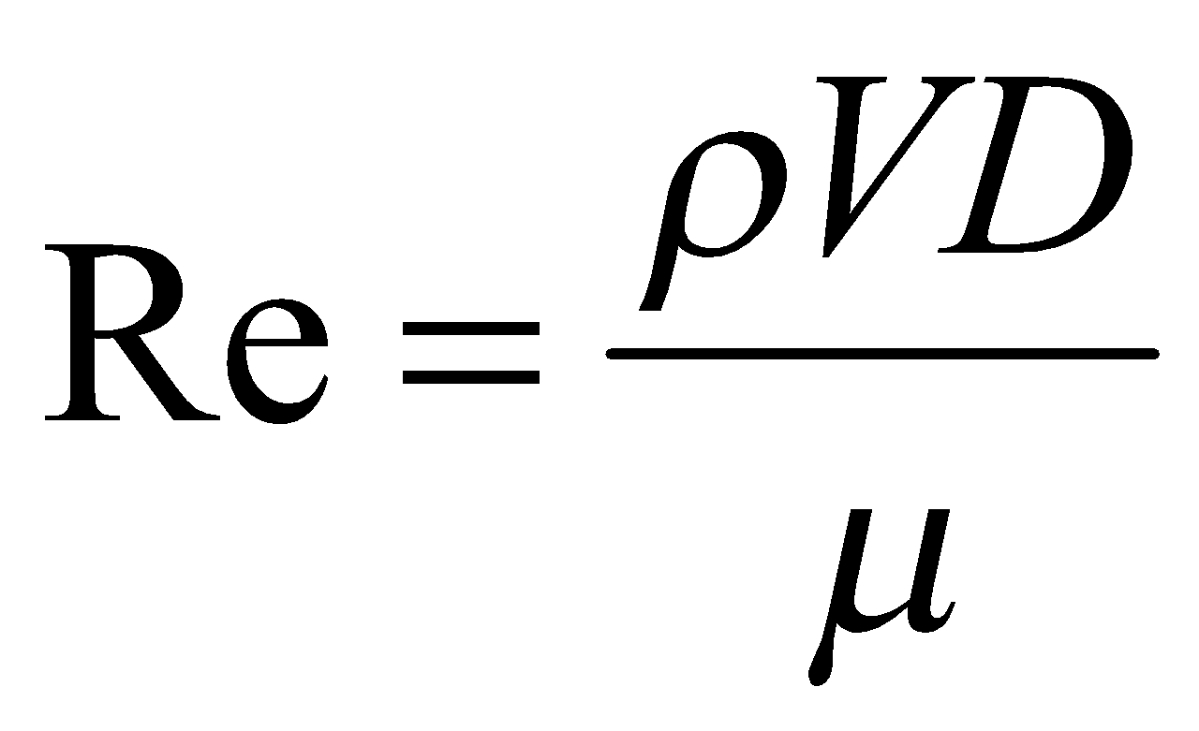
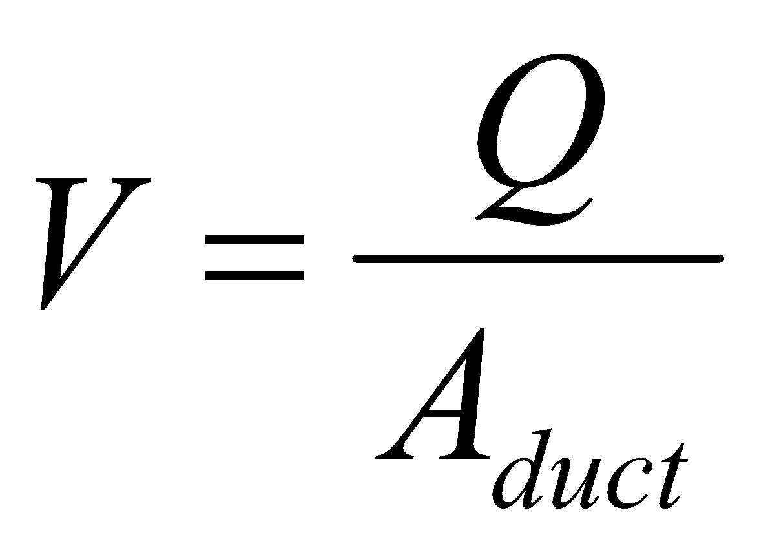
Background Theory
Theory
Heat transfer coefficient calculated through correlation of dimensionless quantities
For forced convection, Nusselt number
  For air flow over circular cylinders
  Reynolds number
  Velocity
  How to get Q?
Schematic Diagram
Thermal Conductivity of Fluid
V
D
Volume Flowrate

Slide 5
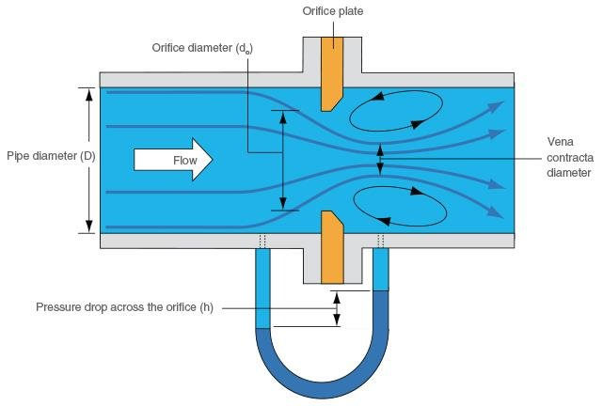
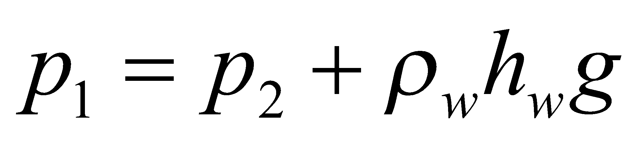
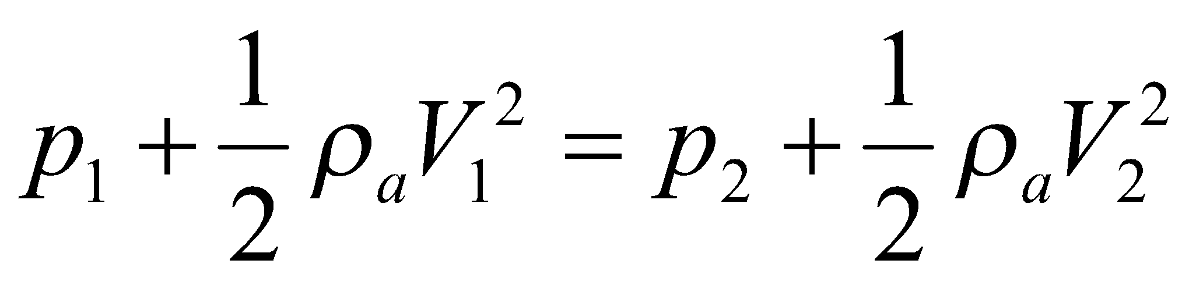
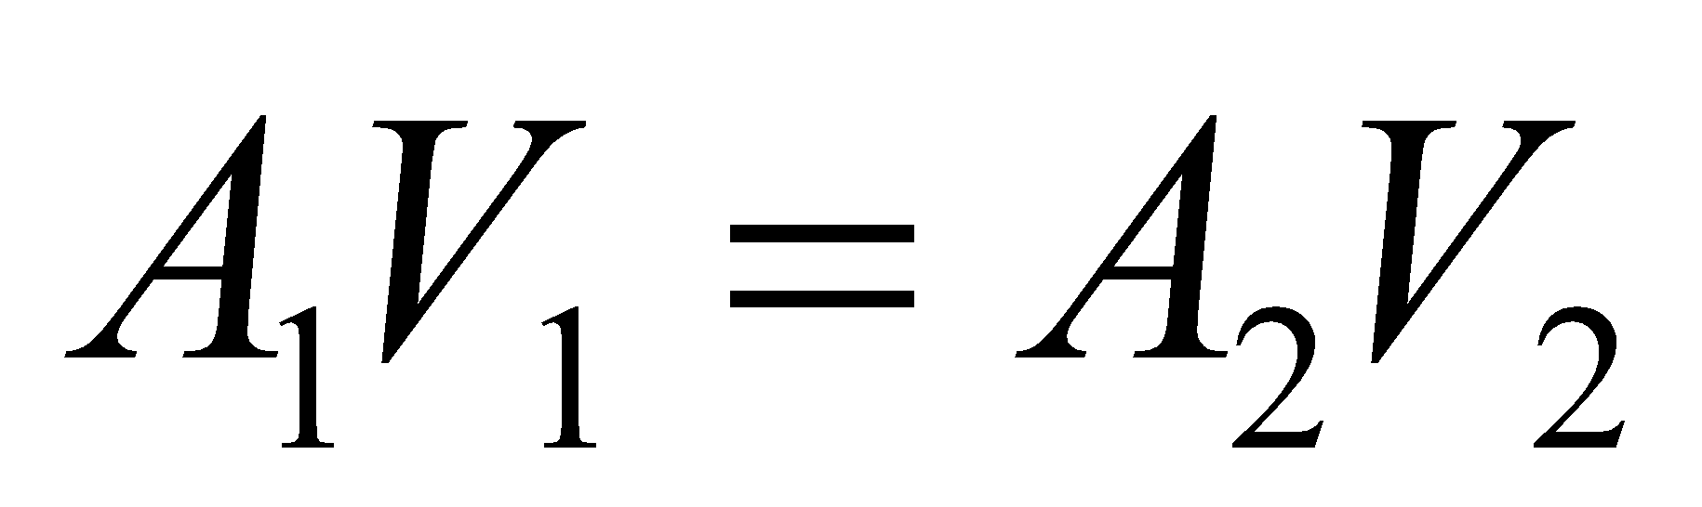
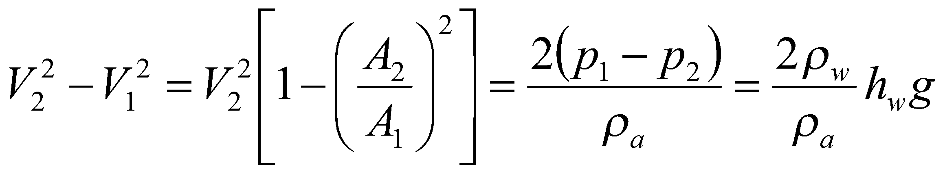
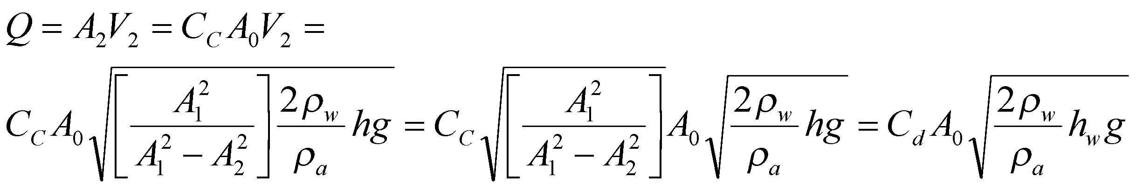
Background Theory
Theory
Schematic Diagram
In the U-tube,
In an orificememter
Volume Flow Rate
A₁
1
A₀
2
A₂
h_{w}
Coefficient of Contraction
Area of Vena Contracta
Area of Orifice
Coefficient of Discharge
C_{d}

Slide 6
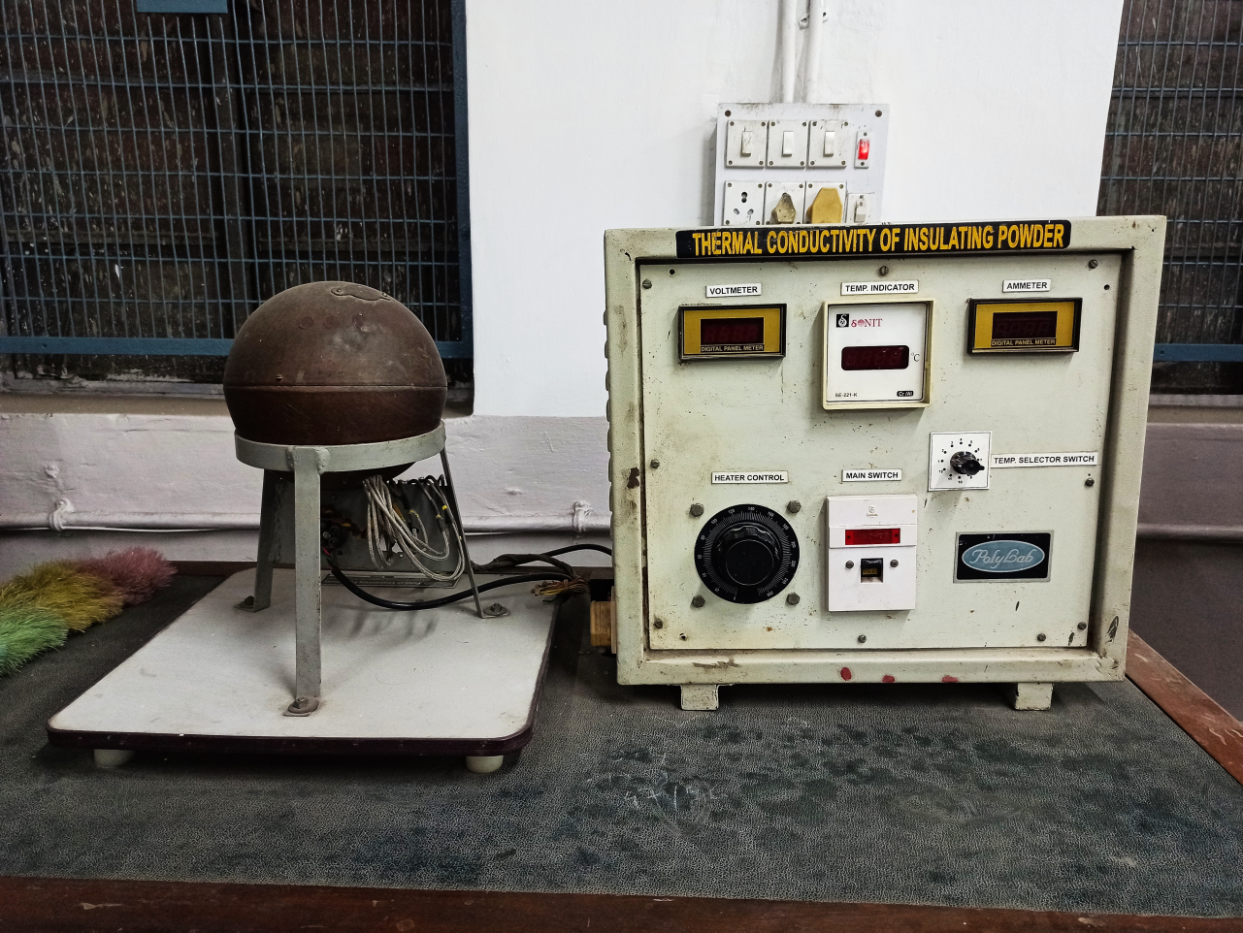
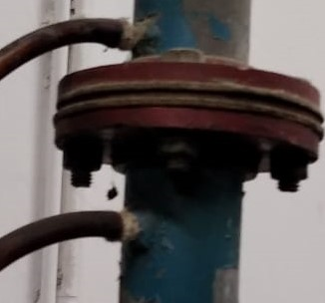
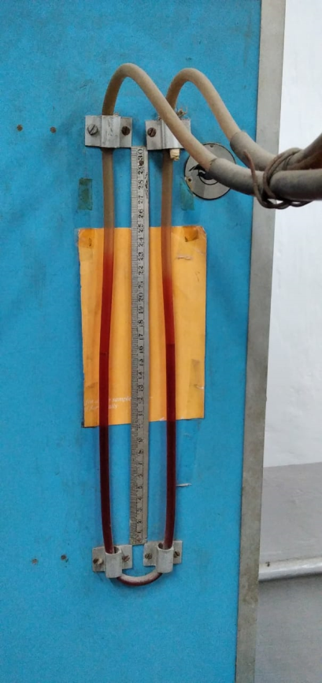
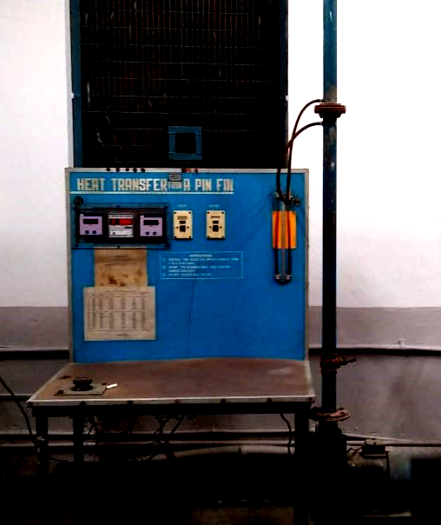
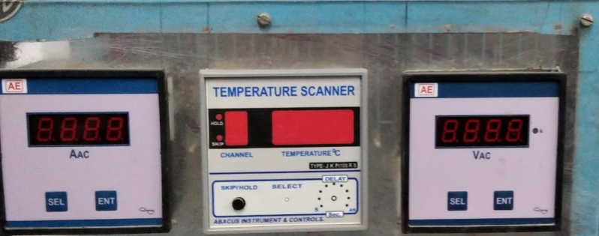
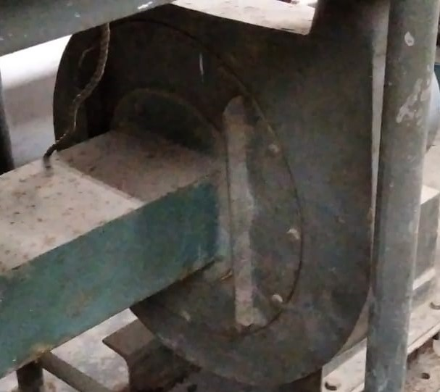
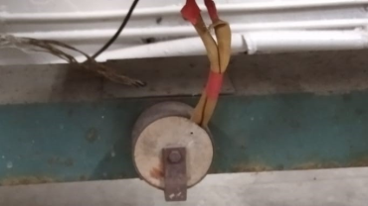
Experimental Setup
Temperature Scanner
Orifice Plate
Ammeter
Voltmeter
Manometer
Dimmerstat
Blower
Heater
Duct

Slide 7
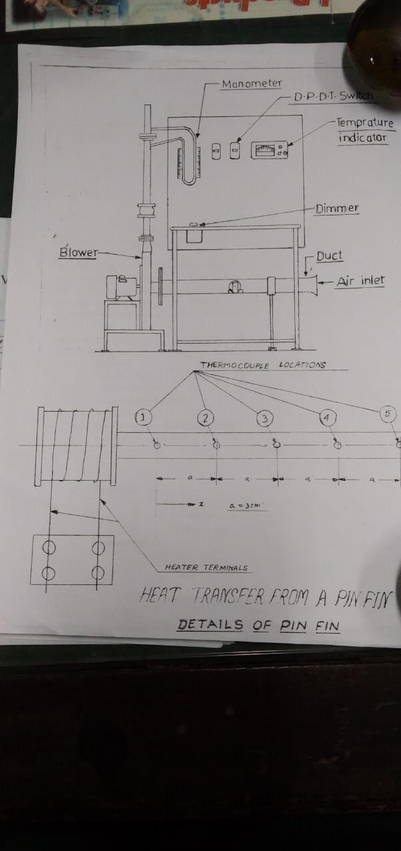
Schematic Sketch

Slide 8
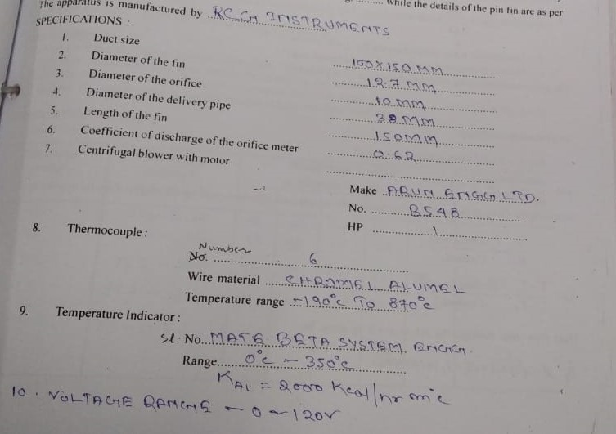
Specifications

Slide 9
Procedure
Start heating the fin by switching the heater and adjusting the dimmerstat voltage to a specific value
Start the blower and adjust the difference of level in manometer (h_{w}) to a specific value with the help of a valve
When steady state is reached, record the final readings T₁ to T₅ and also record the ambient temperature
Repeat the experiment with different values of h_{w}
Put off the main switch

Slide 10
Precautions
Never exceed the heater voltage more than 120 volts
See that the dimmerstat is at zero before switching on the heater
Be sure the steady state is reached before taking the final readings

Slide 11
Observations
Fin Base Location for Theoretical Calculation
Dimmer-stat Voltage (V) | Mano-meter Reading , h_{w} (cm H₂O) | Steady-state Fin Temp at Diff Locations °C |  |  |  |  | Fluid Ambient Temp °C
 |  | T₁ | T₂ | T₃ | T₄ | T₅

Slide 12
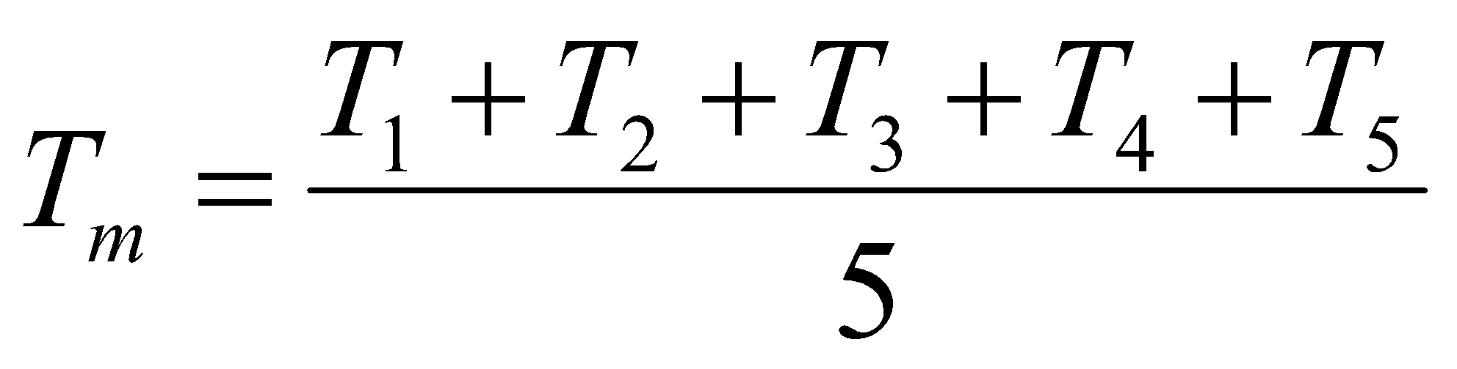
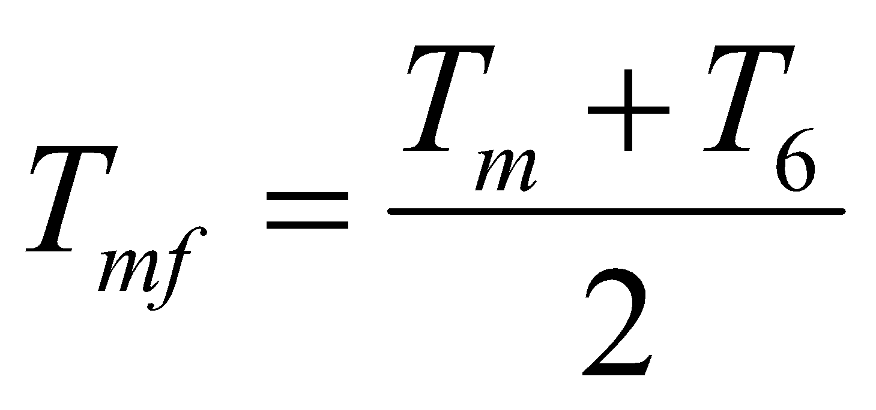
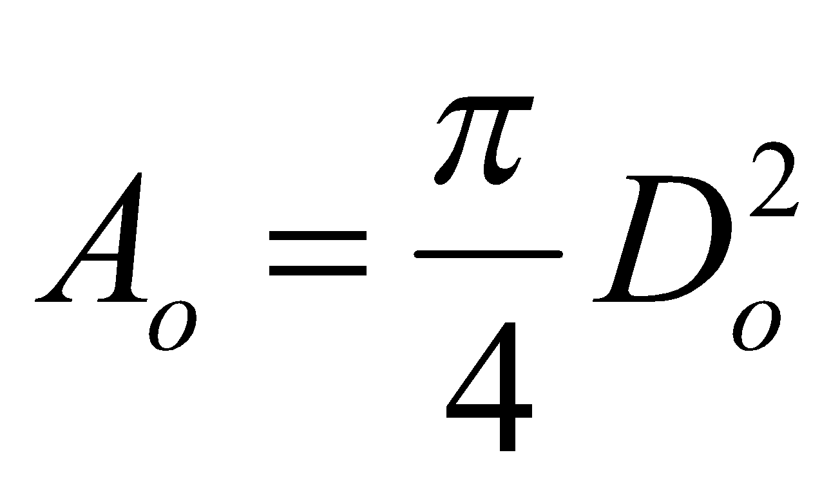
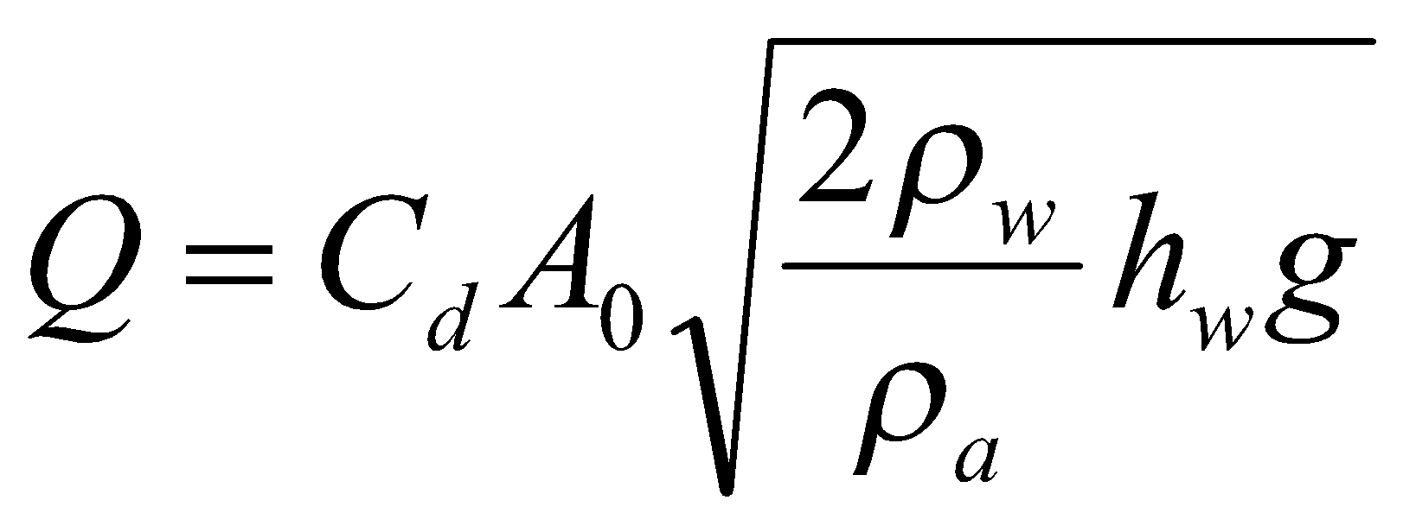
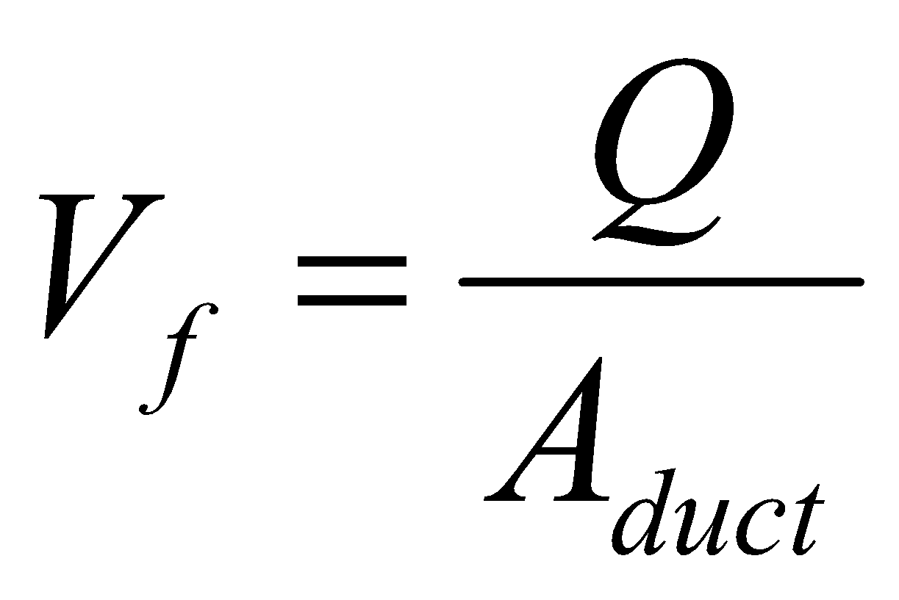
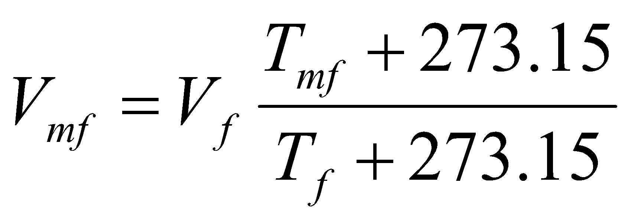
Calculations
Calculate film temperature
Calculate mean film temperature
Area of orifice
Calculate the volume flow rate
Velocity of air at T_{f}
Velocity of air at T_{mf}

Slide 13

Results
Plot temperature distribution along the fin (experimental temperature distribution)
Calculate the fluid properties at T_{mf}
Calculate Re and Nu
Calculate heat transfer coefficient h, rate of heat transfer and fin efficiency
Obtain theoretical temperature distribution assuming insulated tip
Show all the steps for one run as Sample Calculations
Plot theoretical and experimental temperature profiles for each case on the same graph

Slide 14
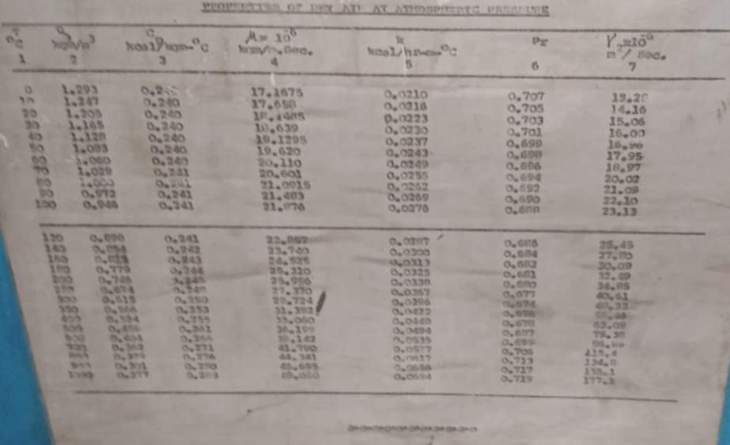
Fluid Properties
Back

