Slide 1
Computer Programming
Session: 2020-21
Semester: 2nd
Operators in C
Part III
Achintya Mukhopadhyay

Slide 2
Relational Operators
Four relational operators in C
  Left to right associativity for operators
Two equality operators in C
  Left to right associativity
  Lower order of precedence than relational operators
Six operators used to form logical expressions
  Represent conditions that are either true or false
  Resulting expressions will be of type integer,
    True is represented by the integer value 1 and False is represented by the value 0.
Operator | Meaning
< | Less than
<= | Less than or equal to
> | Greater than
>= | Greater than or equal to
Operator | Meaning
== | Equal to
!= | Not equal to

Slide 3
Illustrations
int i=1, j=2, k=3;
Exprerssion | Interpretation | Value
i < j | True | 1
(1+j) >= k | True | 1
(j+k)>(i+5) | False | 0
k != 3 | False | 0
j == 2 | True | 1

Slide 4
Logical Operators
Two logical operators in C (also called logical connectors)
  Called logical and and logical or
  Logical and has higher precedence than logical or
  Both have lower precedence than equality operators
  Left to right connectivity
Also a unary operator in C called logical not or logical negation
  Negates the value of a logical expression (Causes an originally true expression to become false and vice versa)
Operator | Meaning
&& | and
|| | or

Slide 5
Logical OR, Logical AND, Logical NOT
expression 1 || expression 2
expression 1 | expression 2 | expression 1 || expression 2
TRUE | TRUE | TRUE
TRUE | FALSE | TRUE
FALSE | TRUE | TRUE
FALSE | FALSE | FALSE
expression 1 && expression 2
expression 1 | expression 2 | expression 1 || expression 2
TRUE | TRUE | TRUE
TRUE | FALSE | FALSE
FALSE | TRUE | FALSE
FALSE | FALSE | FALSE
!expression
expression | !expression
TRUE | FALSE
FALSE | TRUE

Slide 6
Illustrations
int i=7; float f=5.5; char c=‘w’
Exprerssion | Interpretation | Value
(i >= 6) && (c == ' w ' ) True True | True | 1
(i >= 6) || (c == 119) True True | True | 1
(f<11) && (i>100) True False | False | 0
(c != ‘p’)||((i+f)<=10) True False | True | 1
!(f<5) False | True | 1
!(i>(f+1)) True | False | 0

Slide 7
Complex Logical Expressions
Complex logical expressions consist of individual logical expressions joined together by the logical operators && and ||
  Evaluated left to right, but only until the overall true/false value has been established.
  A complex logical expression will not be evaluated in its entirety if its value can be established from its constituent operands
Example
int i=7; float f=5.5; char c=‘w’
Exprerssion | Interpretation | Value
(i >= 6) && (c == ' w ' ) True True | True | 1 | Both expressions evaluated
(i >= 6) || (c == 119) True True | True | 1 | Only first expression evaluated
(i>100) && (f<11) False True | False | 0 | Only first expression evaluated

Slide 8
Conditional Operators
Simple conditional operations can be carried out with the conditional operator
  An expression that makes use of the conditional operator is called a conditional expression
The syntax is
expression 1?expression 2:expression3
  First expression 1 is evaluated
  If expression 1 is true (i.e., its value is not 0), expression 2 is evaluated and it becomes the value of the conditional expression
  If expression 1 is false (i.e., its value is 0), expression 3 is evaluated and it becomes the value of the conditional expression
Example
min =(a<b)?a:b;
The above statement finds the minimum of two numbers a and b. If a<b, min = a else min = b

Slide 9
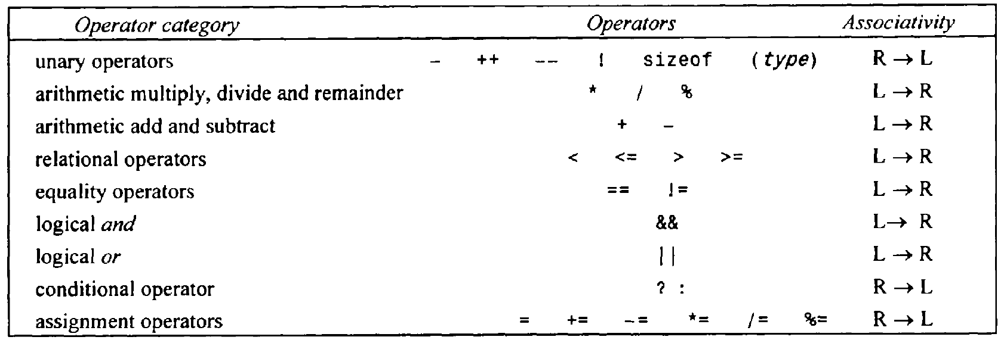
Order of Precedence

Slide 10
Illustration
c += (a > 0 && a <= 10) ? ++a : a/b;
  Step1: Evaluate a > 0 && a <= 10
  Step 2: Evaluate ++a or a/b
  Step 3: Assignment (+=) is carried out

