Slide 1
Antenna Array

Slide 2
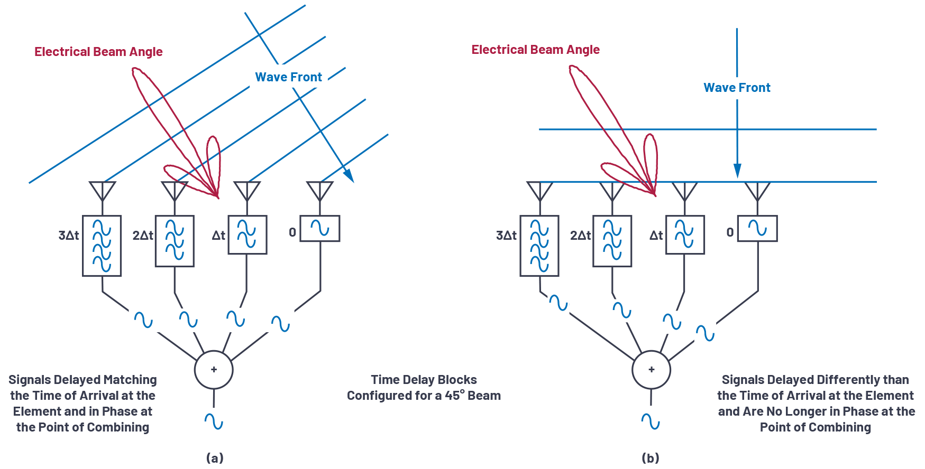

Slide 3
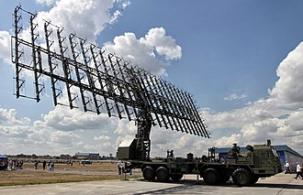

Slide 4
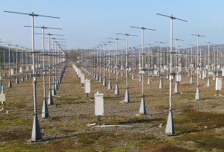

Slide 5
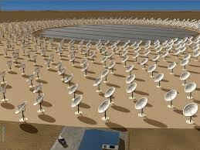

Slide 6
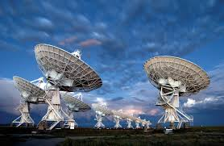

Slide 7
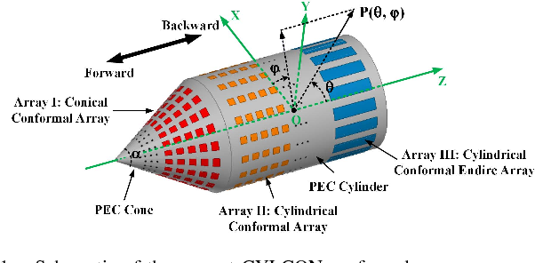

Slide 8
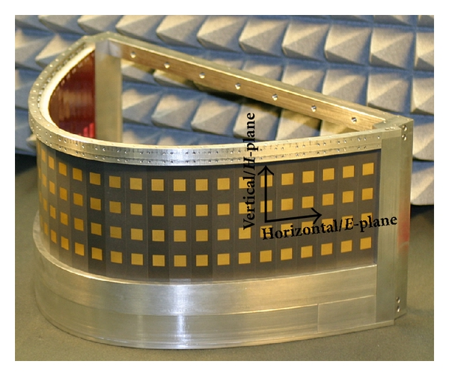
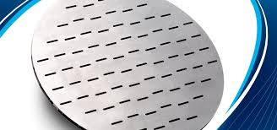

Slide 9
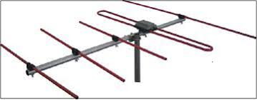
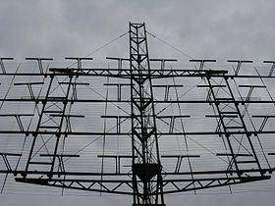

Slide 10
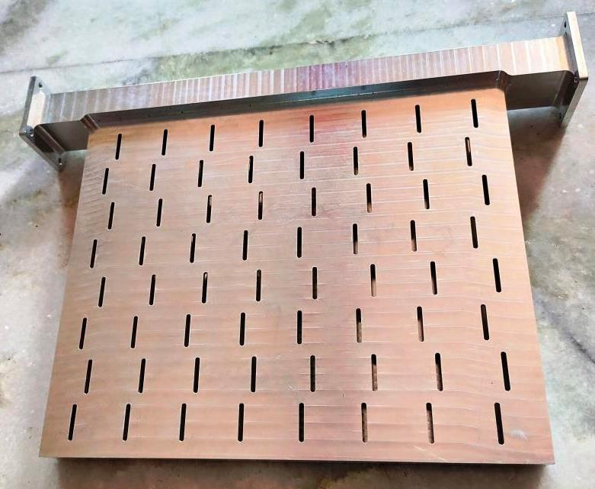
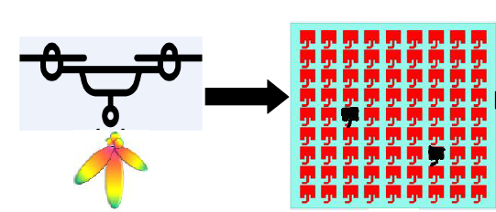
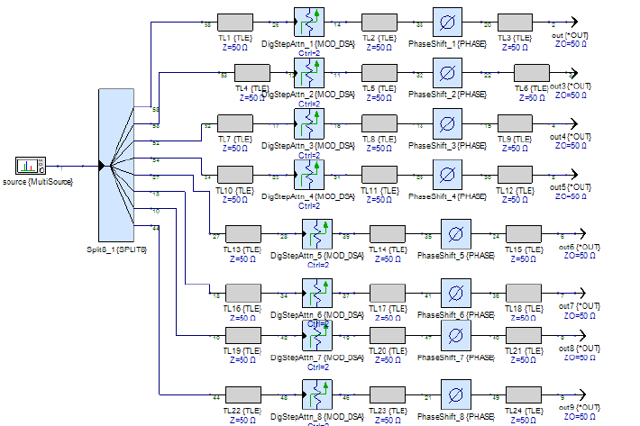

Slide 11
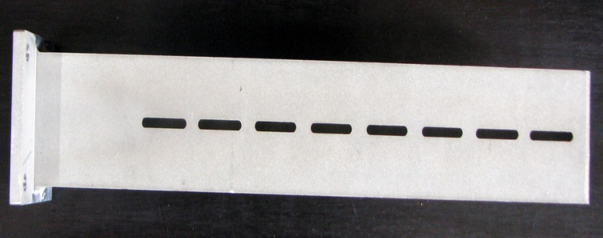
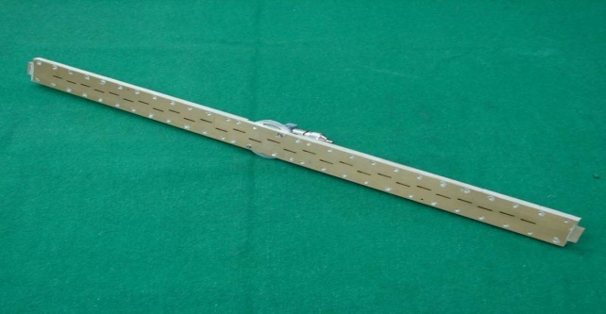
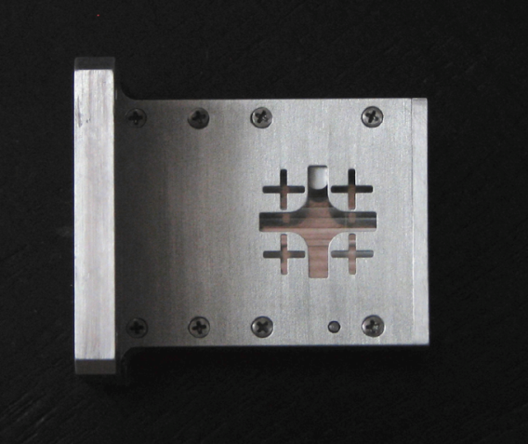
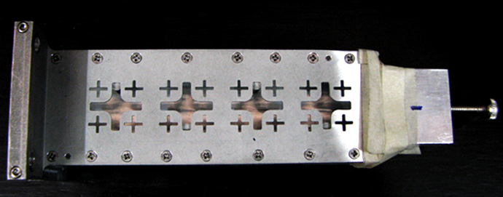
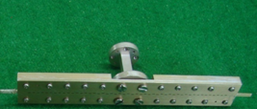
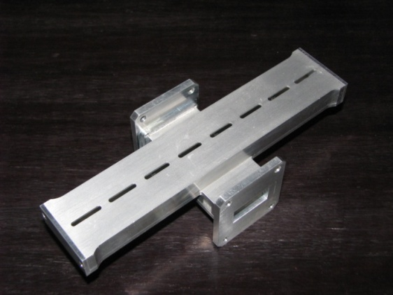
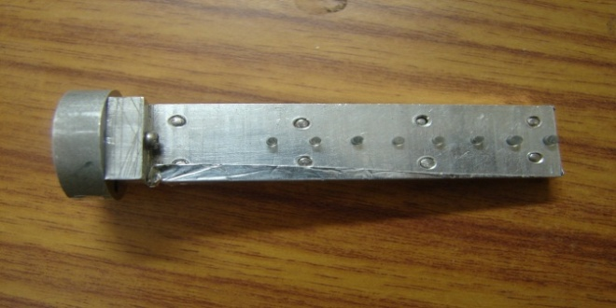
Development in Slotted Array Antenna

Slide 12
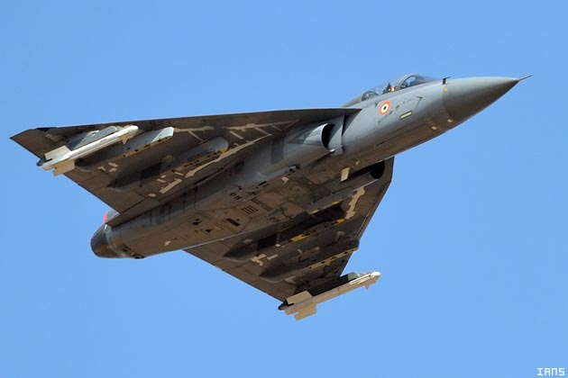
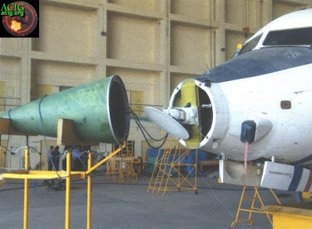
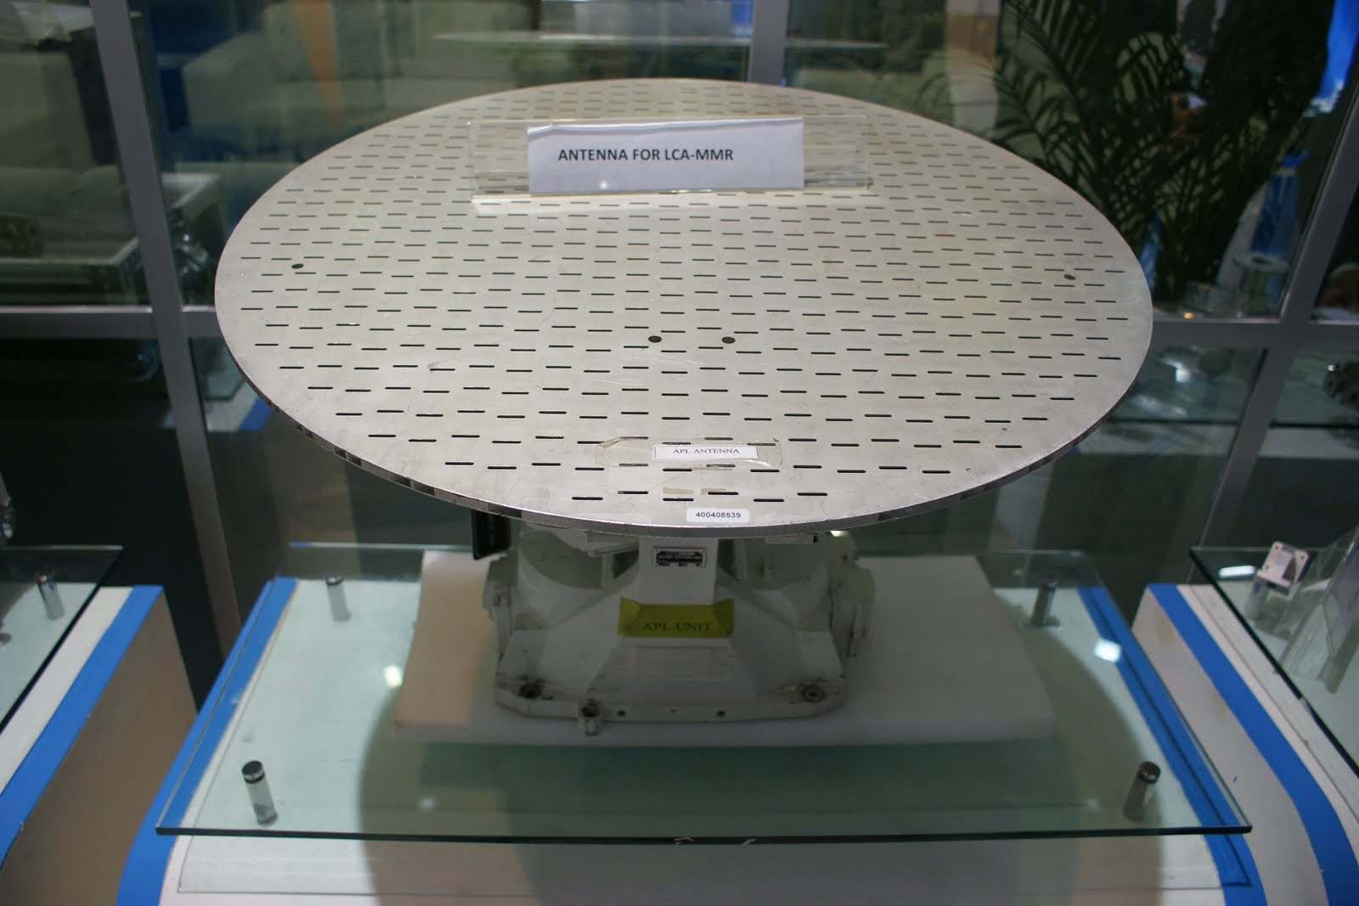
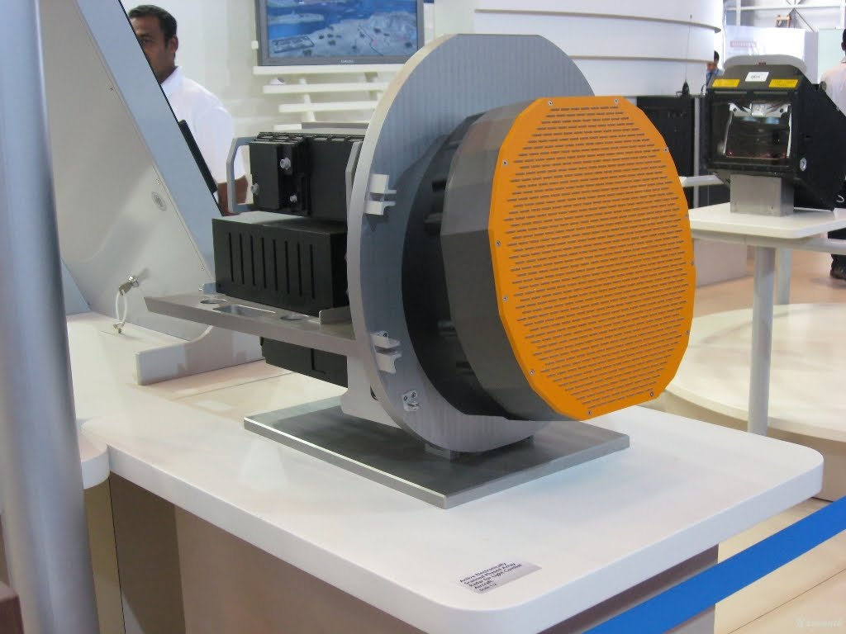
Monopulse RADAR in Light Combat Aircraft (Tejas)
Slotted array antenna at X band in LCA MMR

Slide 13
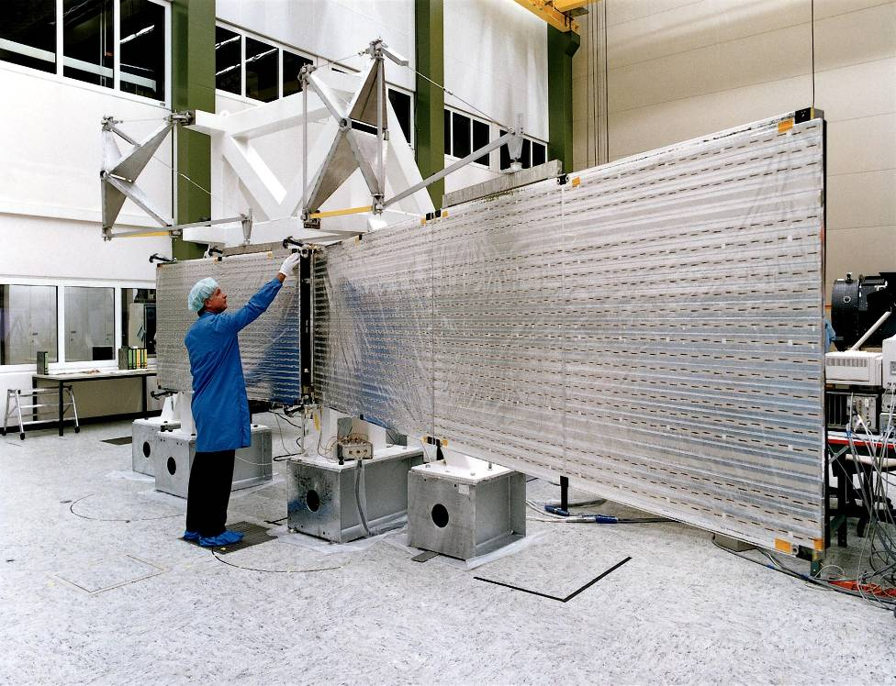
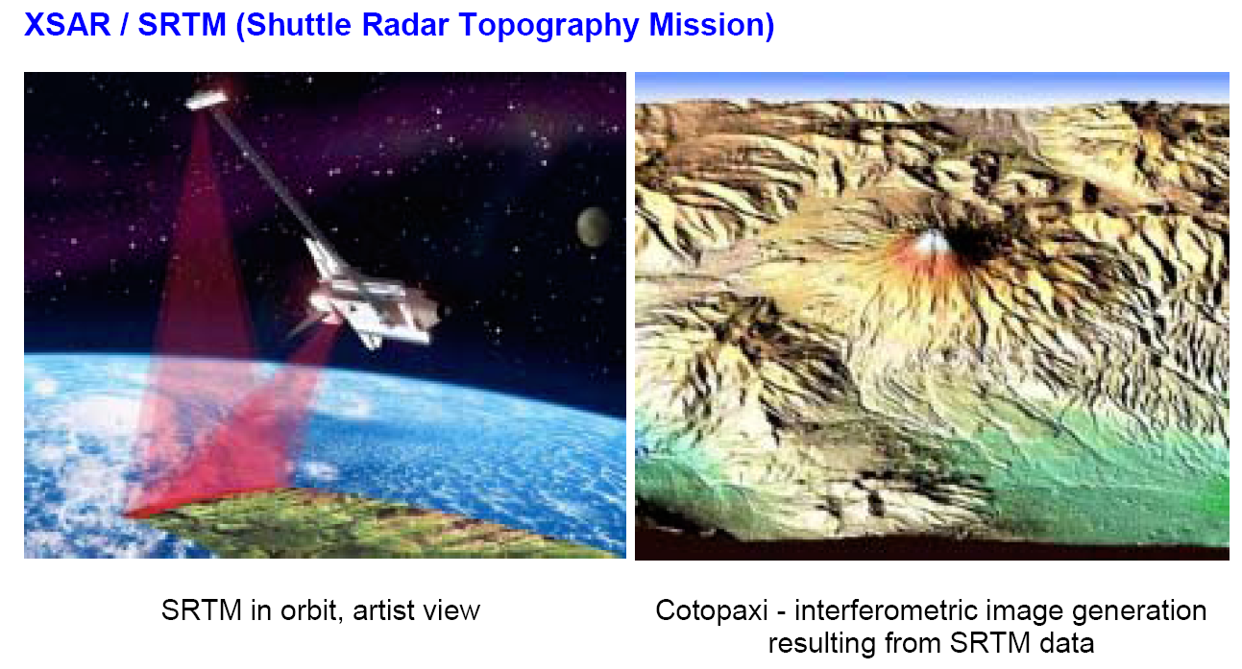
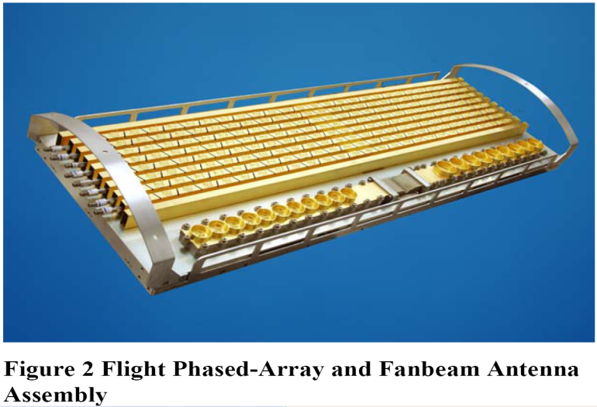
Shuttle RADAR Topographic Mission
C Band (5GHz) Slotted array for Satellite Reception
X Band (9.6GHz) Slotted array for Topographic SAR
MESSENGER (MErcury Surface, Space ENvironment, GEochemistry and Ranging)

Slide 14
Advantages
The following are the advantages of using antenna arrays −
The signal strength increases
High directivity is obtained
Minor lobes are reduced much
High Signal-to-noise ratio is achieved
High gain is obtained
Power wastage is reduced
Better performance is obtained
Disadvantages
The following are the disadvantages of array antennas −
Resistive losses are increased
Mounting and maintenance is difficult
Huge external space is required

Slide 15
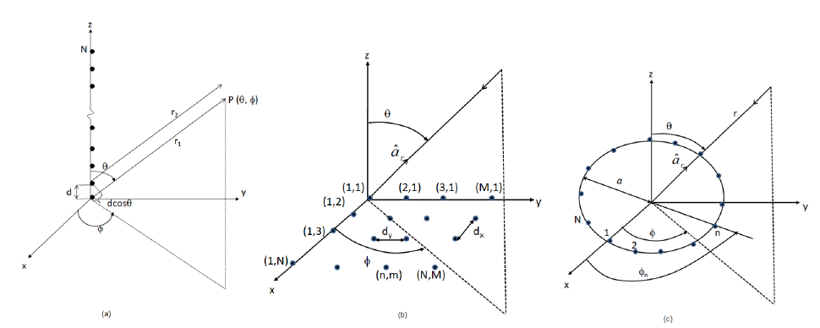
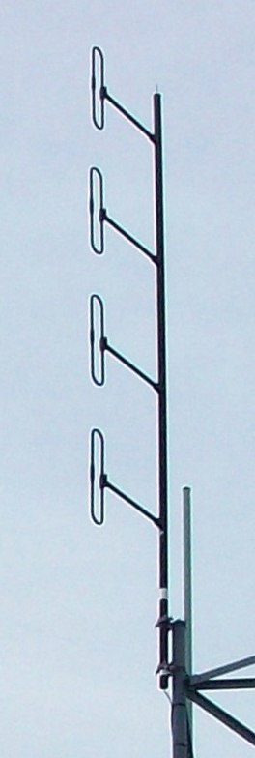
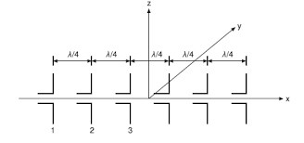

Slide 16
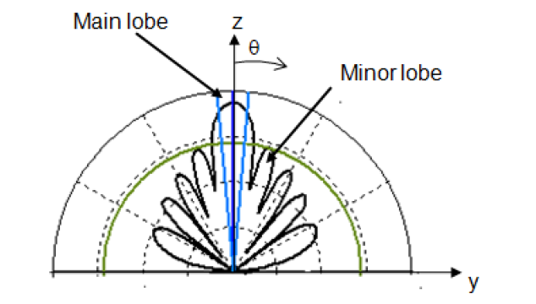
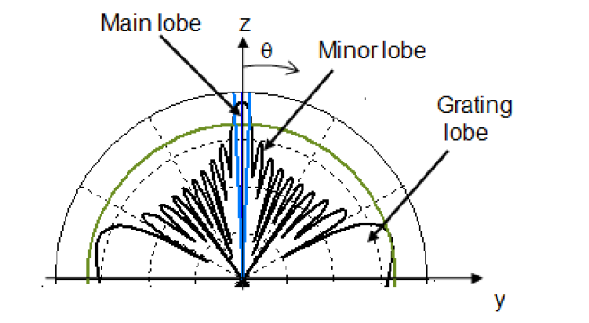

Slide 17
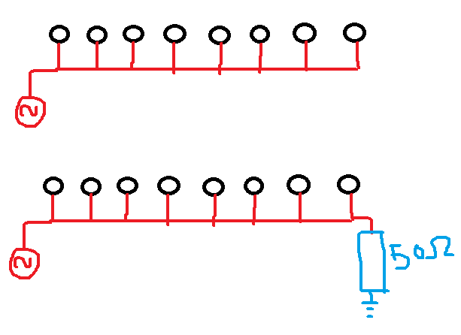
Short circuit
Resonant array
Travelling wave array

Slide 18
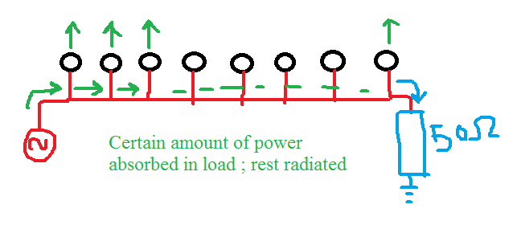
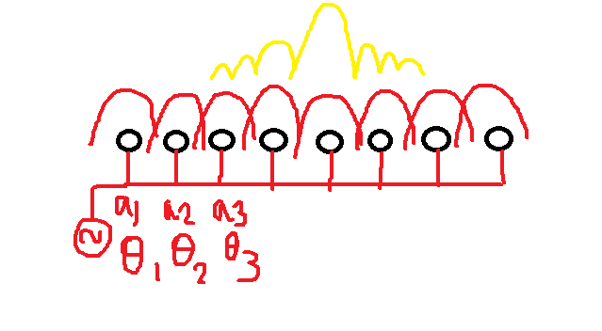

Slide 19
Each element will have an amplitude called excitation amplitude ; got from source
Each element have phase relative to source
Two kinds of phase ; i) phase from source, ii) phase between the inter-element called spatial phase
Now when all the element radiating then there will be phasor addition
As the amount of power due to all radiating elements is increased hence gain increases

Slide 20
We know that if gain increases then pattern looks like directive
More directive pattern means beamwidth decreases.
So antenna array is used for directive radiation pattern
Now what is the distribution ratio of amplitudes?
Now if all a1, a2, a3… are equal we call them uniform array

Slide 21
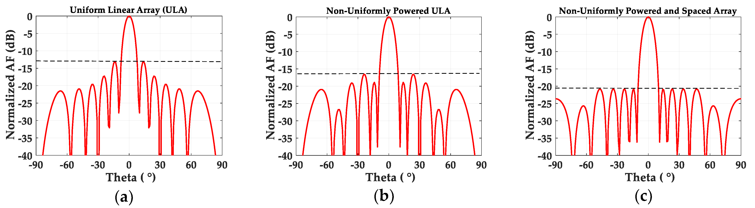
But there are some other distribution termed under non uniform distribution
Typically Binomial . Chebyshev, Taylor etc

